Slide 1
X.509 Certificates & PKI
Howon Kim
2019

Slide 2
Agenda
X.509 Authentication Service
Public Key Infrastructure
2
Notes:
2

Slide 3
X.509 Authentication Service
3
part of CCITT X.500 directory service standards
  distributed servers maintaining some info database
defines framework for authentication services
  directory may store public-key certificates
  with public key of user
  signed by certification authority’s private key
also defines authentication protocols
uses public-key crypto & digital signatures
  algorithms not standardised, but RSA recommended
Notes:
X.509 is the Internationally accepted standard for how to construct a public key certificate, and is becoming widely used. It has gone through several versions. It is used by S/MIME secure email, SSL/TLS secure Internet links (eg for secure web).

Slide 4
The Generation of Public-key Certificate
Unsigned certificate:
Contains user ID,
User’s public key
Generate hash code of unsigned certificate
H
Encrypt hash code with CA’s private key to form signature
E
Signed certificate:
Recipient can verify
signature using CA’s public key
4
Notes:
X.509 is the Internationally accepted standard for how to construct a public key certificate, and is becoming widely used. It has gone through several versions. It is used by S/MIME secure email, SSL/TLS secure Internet links (eg for secure web).

Slide 5
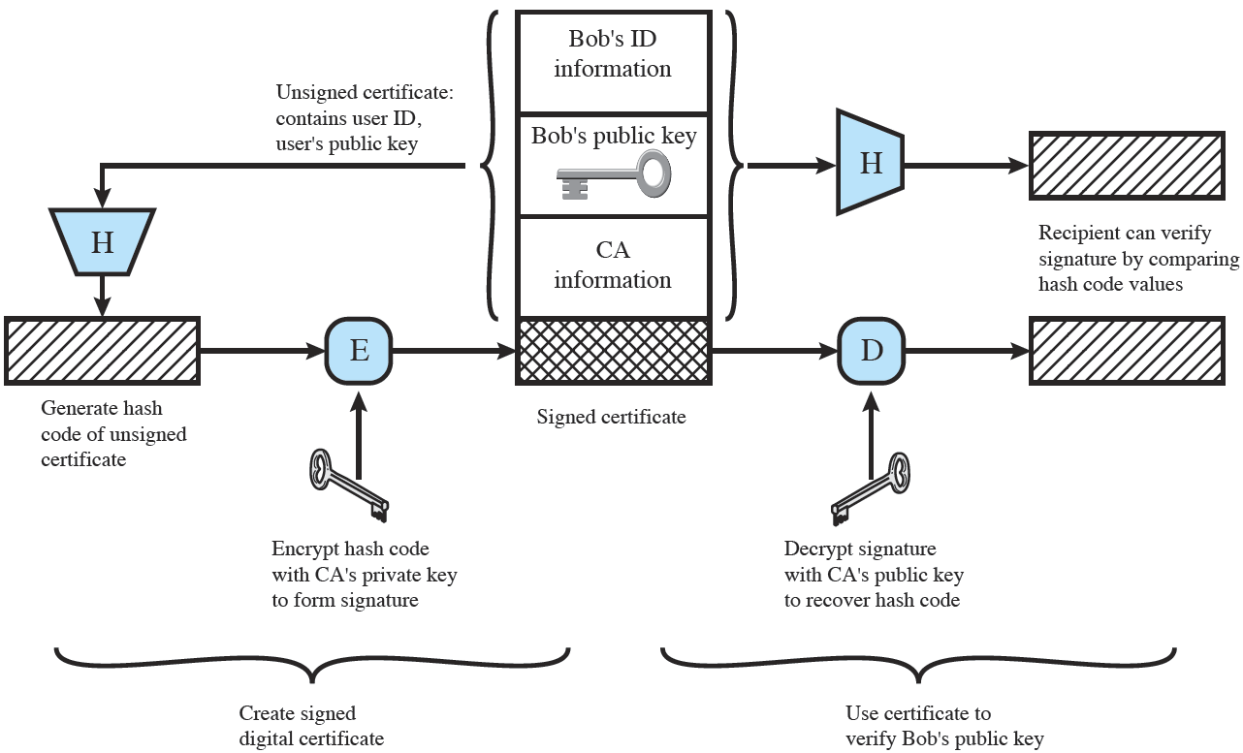
The Generation of Public-key Certificate
5
Notes:
X.509 is the Internationally accepted standard for how to construct a public key certificate, and is becoming widely used. It has gone through several versions. It is used by S/MIME secure email, SSL/TLS secure Internet links (eg for secure web).

Slide 6
X.509 Certificates
6
issued by a Certification Authority (CA), containing:
  version (1, 2, or 3)
  serial number (unique within CA) identifying certificate
  signature algorithm identifier
  issuer X.500 name (CA)
  period of validity (from - to dates)
  subject X.500 name (name of owner)
  subject public-key info (algorithm, parameters, key)
  issuer unique identifier (v2+)
  subject unique identifier (v2+)
  extension fields (v3)
  signature (of hash of all fields in certificate)
notation CA<<A>> denotes certificate for A signed by CA
Notes:
The X.509 certificate is the heart of the standard. There are 3 versions, with successively more info in the certificate - must be v2 if either unique identifier field exists, must be v3 if any extensions are used.

Slide 7
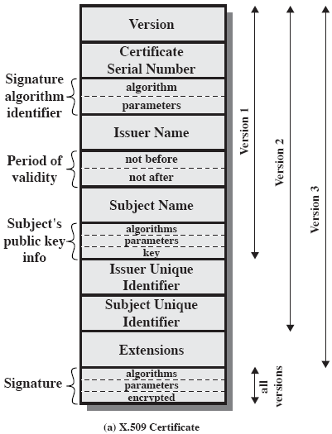
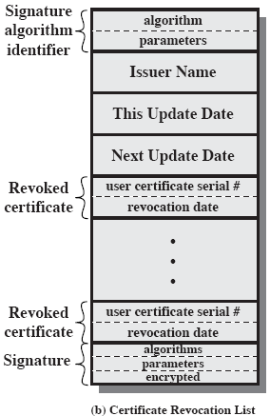
X.509 Certificates
7
Notes:
Stallings Fig 14.3

Slide 8
X.509 Version 3
Version 2 format does not convey all of the information that recent design and implementation experience has shown to be needed
Rather than continue to add fields to a fixed format, standards developers felt that a more flexible approach was needed
  Version 3 includes a number of optional extensions
  The certificate extensions fall into three main categories:
  Key and policy information
  Subject and issuer attributes
  Certification path constraints
Each extension consists of:
An extension identifier
A criticality indicator
An extension value
Notes:
The X.509 version 2 format does not convey all of the information that recent design
and implementation experience has shown to be needed. [FORD95] lists the following
requirements not satisfied by version 2.
1. The subject field is inadequate to convey the identity of a key owner to a public-
key user. X.509 names may be relatively short and lacking in obvious identification
details that may be needed by the user.
2. The subject field is also inadequate for many applications, which typically recognize
entities by an Internet e-mail address, a URL, or some other Internet related
identification.
3. There is a need to indicate security policy information. This enables a security application
or function, such as IPSec, to relate an X.509 certificate to a given policy.
4. There is a need to limit the damage that can result from a faulty or malicious
CA by setting constraints on the applicability of a particular certificate.
5. It is important to be able to identify different keys used by the same owner at
different times. This feature supports key lifecycle management: in particular,
the ability to update key pairs for users and CAs on a regular basis or under
exceptional circumstances.
Rather than continue to add fields to a fixed format, standards developers
felt that a more flexible approach was needed. Thus, version 3 includes a number
of optional extensions that may be added to the version 2 format. Each extension
consists of an extension identifier, a criticality indicator, and an extension value.
The criticality indicator indicates whether an extension can be safely ignored. If
the indicator has a value of TRUE and an implementation does not recognize the
extension, it must treat the certificate as invalid.
The certificate extensions fall into three main categories: key and policy information,
subject and issuer attributes, and certification path constraints.

Slide 9
X.509 Version 3: Key and Policy Information
These extensions convey additional information about the subject and issuer keys plus indicators of certificate policy
A certificate policy is a named set of rules that indicates the applicability of a certificate to a particular community and/or class of application with common security requirements
Included are:
Authority key identifier
Subject key identifier
Key usage
Private-key usage period
Certificate policies
Policy mappings
Notes:
These extensions convey additional information
about the subject and issuer keys, plus indicators of certificate policy. A certificate
policy is a named set of rules that indicates the applicability of a certificate to a particular
community and/or class of application with common security requirements.
For example, a policy might be applicable to the authentication of electronic data
interchange (EDI) transactions for the trading of goods within a given price range.
This area includes:
• Authority key identifier: Identifies the public key to be used to verify the signature
on this certificate or CRL. Enables distinct keys of the same CA to be
differentiated. One use of this field is to handle CA key pair updating.
• Subject key identifier: Identifies the public key being certified. Useful for subject
key pair updating. Also, a subject may have multiple key pairs and, correspondingly,
different certificates for different purposes (e.g., digital signature
and encryption key agreement).
• Key usage: Indicates a restriction imposed as to the purposes for which, and
the policies under which, the certified public key may be used. May indicate
one or more of the following: digital signature, nonrepudiation, key encryption,
data encryption, key agreement, CA signature verification on certificates,
CA signature verification on CRLs.
• Private-key usage period: Indicates the period of use of the private key corresponding
to the public key. Typically, the private key is used over a different
period from the validity of the public key. For example, with digital signature
keys, the usage period for the signing private key is typically shorter than that
for the verifying public key.
• Certificate policies: Certificates may be used in environments where multiple
policies apply. This extension lists policies that the certificate is recognized as
supporting, together with optional qualifier information.
• Policy mappings: Used only in certificates for CAs issued by other CAs. Policy
mappings allow an issuing CA to indicate that one or more of that issuer’s
policies can be considered equivalent to another policy used in the subject
CA’s domain.

Slide 10
X.509 Version 3: Certificate Subject and Issuer Attributes
These extensions support alternative names, in alternative formats, for a certificate subject or certificate issuer
Can convey additional information about the certificate subject to increase a certificate user’s confidence that the certificate subject is a particular person or entity
The extension fields in this area include:
  Subject alternative name
  Issuer alternative name
  Subject directory attributes
Notes:
These extensions support alternative
names, in alternative formats, for a certificate subject or certificate issuer and can
convey additional information about the certificate subject to increase a certificate
user’s confidence that the certificate subject is a particular person or entity. For
example,
information such as postal address, position within a corporation, or picture
image may be required.
The extension fields in this area include:
• Subject alternative name: Contains one or more alternative names, using any of a
variety of forms. This field is important for supporting certain applications, such
as electronic mail, EDI, and IPSec, which may employ their own name forms.
• Issuer alternative name: Contains one or more alternative names, using any of
a variety of forms.
• Subject directory attributes: Conveys any desired X.500 directory attribute
values for the subject of this certificate.

Slide 11
X.509 Version 3: Certification Path Constraints
These extensions allow constraint specifications to be included in certificates issued for CAs by other CAs
The constraints may restrict the types of certificates that can be issued by the subject CA or that may occur subsequently in a certification chain
The extension fields in this area include:
  Basic constraints
  Name constraints
  Policy constraints
Notes:
These extensions allow constraint specifications
to be included in certificates issued for CAs by other CAs. The constraints may
restrict the types of certificates that can be issued by the subject CA or that may
occur subsequently in a certification chain.
The extension fields in this area include:
• Basic constraints: Indicates if the subject may act as a CA. If so, a certification
path length constraint may be specified.
• Name constraints: Indicates a name space within which all subject names in
subsequent certificates in a certification path must be located.
• Policy constraints: Specifies constraints that may require explicit certificate
policy identification or inhibit policy mapping for the remainder of the certification
path.

Slide 12
The elements of a certificate
12
Version:
  Differentiates among successive versions of the certificate format; the default is version 1. If the Issuer Unique Identifier or Subject Unique Identifier are present, the value must be version 2. If one or more extensions are present, the version must be version 3.
Serial number:
  An integer value, unique within the issuing CA, that is unambiguously associated with this certificate.
Signature algorithm identifier:
  The algorithm used to sign the certificate, together with any associated parameters. Because this information is repeated in the Signature field at the end of the certificate, this field has little, if any, utility.
Issuer name(발행자 이름):
  X.500 name of the CA that created and signed this certificate.
Period of validity(유효기간):
  Consists of two dates: the first and last on which the certificate is valid.

Slide 13
The elements of a certificate
Subject name (주체 이름: 인증서가 가리키는 사용자):
  The name of the user to whom this certificate refers. That is, this certificate certifies the public key of the subject who holds the corresponding private key.
Subject's public-key information:
  The public key of the subject, plus an identifier of the algorithm for which this key is to be used, together with any associated parameters.
Issuer unique identifier:
  An optional bit string field used to identify uniquely the issuing CA in the event the X.500 name has been reused for different entities.
Subject unique identifier:
  An optional bit string field used to identify uniquely the subject in the event the X.500 name has been reused for different entities.
Extensions:
  A set of one or more extension fields. Extensions were added in version 3 and are discussed later in this section.
Signature:
  Covers all of the other fields of the certificate; it contains the hash code of the other fields, encrypted with the CA's private key. This field includes the signature algorithm identifier.
13

Slide 14
Certificate Saving Format
X.509 certificate
  Expressed as ASN.1
  ASN.1(Abstract Syntax Notation One) structure
    OID(Object Identifiers)
    AI(Algorithm Identifiers)
    DS(X.509 text information)
    DN(X.509 hierarchy name)
    GN(X.509 certificate name)
Certificate file format
  PEM(Privacy Enhanced Mail): Base64 encoded certificate
  DER(distinguished Encoding Rule) : binary encoded certificate
  PFX (Personal Information Exchange) : predecessor of PKCS #12
  P12 : PKCS #12 file format
14

Slide 15
Obtaining a Certificate
15
any user with access to CA can get any certificate from it
only the CA can modify a certificate
because cannot be forged, certificates can be placed in a public directory

Slide 16
Obtaining Certificate from different CAs
16
Getting a certificate from the same CA is not a practical situation for a large community of users
Suppose that A has obtained a certificate from CA X1 and B from CA X2.
  If A does not securely know the public key of X2, then B’s certificate, issued by X2, is useless to A.

Slide 17
Obtaining a User’s Certificate
CA<<A>> denotes certificate for A signed by CA
X1<<X2>>
X2<<B>>
(공인 인증기관의)공개키로 서명을 검증해서 검증된 공개키를 얻게 됨. 얻은 공개키를 사용하여 인증서를 검증한 후, 인증서로부터 검증된 공개키를 얻을 수 있음.
17
A has used a chain of certificates to obtain B's public key. In the notation of X.509, this chain is expressed as
  X1<<X2>> X2<<B>>
  A obtains, from the directory, the certificate of X2 signed by X1. Because A securely knows X1's public key, A can obtain X2's public key from its certificate and verify it by means of X1's signature on the certificate.
  A then goes back to the directory and obtains the certificate of B signed by X2 Because A now has a trusted copy of X2's public key, A can verify the signature and securely obtain B's public key.
In the same fashion, B can obtain A's public key with the reverse chain:
  X2<<X1>> X1<<A>>

Slide 18
CA Hierarchy
18
if both users share a common CA then they are assumed to know its public key
otherwise CA's must form a hierarchy
use certificates linking members of hierarchy to validate other CA's
  each CA has certificates for clients (forward) and parent (backward)
each client trusts parents certificates
enable verification of any certificate from one CA by users of all other CAs in hierarchy
Notes:
All very easy is both parties use the same CA. If not, then there has to be some means to form a chain of certifications between the CA's used by the two parties. And that raises issues about whether the CA's are equivalent, whether they used the same policies to generate their certificates, and how much you're going to trust a CA at some remove from your own. These are all open issues.

Slide 19
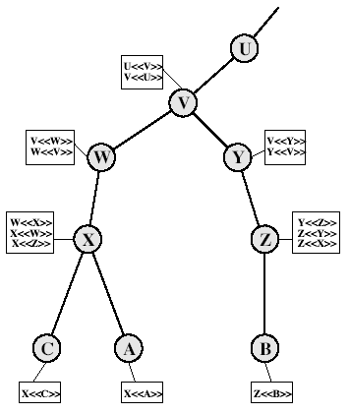
CA Hierarchy Use
In this example, user A can acquire the following certificates from the directory to establish a certification path to B:
X<<W>> W <<V>> V <<Y>>
Y<<Z>> Z <<B>>
A는 certificate chain을 통해 B의 공개키를 안전하게 얻게 됨.
(단 A는 parent의 인증서를 신뢰한다고 가정함)
B can obtain this set of certificates from the directory,
Z<<Y>> Y <<V>> V <<W>>\
W<<X>>X <<A>>
19
Notes:
Stallings Fig 14.4.
Track chains of certificates:
A acquires B certificate using chain: X<<W>>W<<V>>V<<Y>>Y<<Z>>Z<<B>>
B acquires A certificate using chain: Z<<Y>>Y<<V>>V<<W>>W<<X>>X<<A>>

Slide 20
Certificate Revocation (인증서 취소)
20
certificates have a period of validity
may need to revoke before expiry, eg:
  user's private key is compromised
  user is no longer certified by this CA
  CA's certificate is compromised
Each CA must maintain a list of all revoked but not expired certificates issued by that CA
  the Certificate Revocation List (CRL)
users should check certs with CA’s CRL

Slide 21
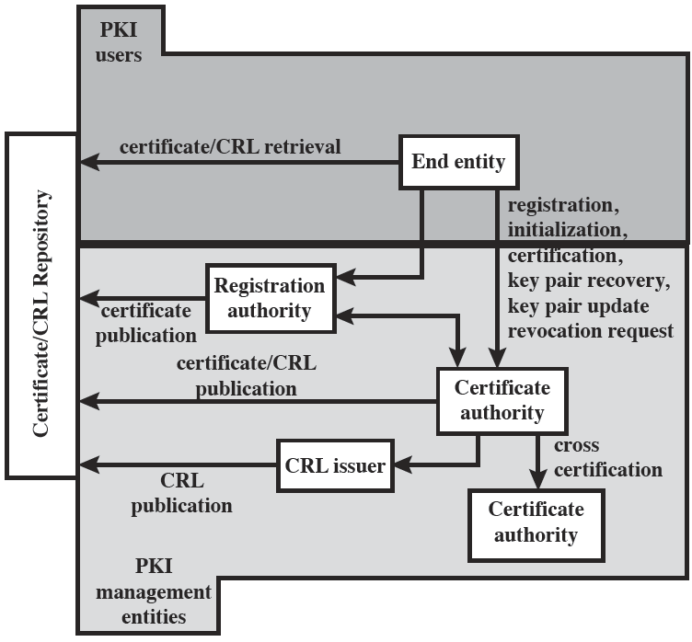
PKIX Architectural Model
This Figure shows the interrelationship among the key elements of the PKIX model. These elements are
• End entity: A generic term used to denote end users, devices (e.g., servers,routers), or any other entity that can be identified in the subject field of a public-key certificate. End entities typically consume and/or support PKI-related services.
• Certification authority (CA): The issuer of certificates and (usually) certificate revocation lists (CRLs). It may also support a variety of administrative functions, although these are often delegated to one or more Registration
Authorities.
• Registration authority (RA): An optional component that can assume a number of administrative functions from the CA. The RA is often associated with the end entity registration process but can assist in a number of other areas as well.
• CRL issuer: An optional component that a CA can delegate to publish CRLs.
• Repository: A generic term used to denote any method for storing certificates and CRLs so that they can be retrieved by end entities.
21

Slide 22
PKIX Management Functions
PKIX identifies a number of management functions that potentially need to be supported by management protocols:
  Registration
  Initialization
  Certification
  Key pair recovery
  Key pair update
  Revocation request
  Cross certification
.
• Registration: This is the process whereby a user first makes itself known to a CA (directly or through an RA), prior to that CA issuing a certificate or
certificates for that user. Registration begins the process of enrolling in a PKI. Registration usually involves some offline or online procedure for mutual authentication. Typically, the end entity is issued one or more shared secret keys used for subsequent authentication.
• Initialization: Before a client system can operate securely, it is necessary to install key materials that have the appropriate relationship with keys stored elsewhere in the infrastructure. For example, the client needs to be securely initialized with the public key and other assured information of the trusted CA(s), to be used in validating certificate paths.
• Certification: This is the process in which a CA issues a certificate for a user’s public key, returns that certificate to the user’s client system, and/or posts that certificate in a repository.
22

Slide 23
PKIX Management Functions
• Key pair recovery: Key pairs can be used to support digital signature creation
and verification, encryption and decryption, or both. When a key pair is used
for encryption/decryption, it is important to provide a mechanism to recover
the necessary decryption keys when normal access to the keying material is
no longer possible, otherwise it will not be possible to recover the encrypted
data. Loss of access to the decryption key can result from forgotten passwords/
PINs, corrupted disk drives, damage to hardware tokens, and so on. Key pair
recovery allows end entities to restore their encryption/decryption key pair
from an authorized key backup facility (typically, the CA that issued the end
entity’s certificate).
• Key pair update: All key pairs need to be updated regularly (i.e., replaced
with a new key pair) and new certificates issued. Update is required when the
certificate lifetime expires and as a result of certificate revocation.
• Revocation request: An authorized person advises a CA of an abnormal situation
requiring certificate revocation. Reasons for revocation include private-key
compromise, change in affiliation, and name change.
• Cross certification: Two CAs exchange information used in establishing a cross-certificate. A cross-certificate is a certificate issued by one CA to another CA that contains a CA signature key used for issuing certificates.
23

Slide 24
Authentication Procedures
24
X.509 includes three alternative authentication procedures that are intended for use across a variety of applications
Assumption: two parties know each other’s public key
  One-Way Authentication
  Two-Way Authentication
  Three-Way Authentication
all use public-key signatures
Notes:
The X.509 standard specifies the authentication protocols that can be used when obtaining and using certificates. 1-way for unidirectional messages (like email), 2-way for interactive sessions when timestamps are used, 3-way for interactive sessions with no need for timestamps (and hence synchronised clocks).

Slide 25
Nonce
a nonce is a parameter that varies with time. A nonce can be a time stamp, a visit counter on a Web page, or a special marker intended to limit or prevent the unauthorized replay or reproduction of a file.

Slide 26
Nonce
from RFC 2617:
  For applications where no possibility of replay attack can be tolerated the server can use one-time nonce values which will not be honored for a second use. This requires the overhead of the server remembering which nonce values have been used until the nonce time-stamp (and hence the digest built with it) has expired, but it effectively protects against replay attacks.

Slide 27
One-Way Authentication
27
One way authentication involves a single transfer of information from A to B, and establishes the following:
  the identity of A and that message is from A
  message was intended for B
  integrity & originality of message

Slide 28
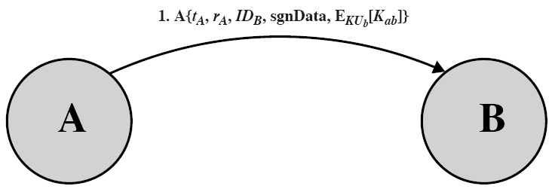
One-Way Authentication
message must include timestamp t_{A}, nonce r_{A}, B's identity (ID_{B}) and is signed by A
  Time stamp prevents delayed delivery of messages
  Nonce can be used to detect replay attacks
may include additional info for B
  For conveying user data to B (sgnData), or session key K_{ab}(encrypted with B’s public key)
Note that only the identity of the initiating entity is verified in this process, not that of the responding entity.
A에의해 서명됨
28

Slide 29

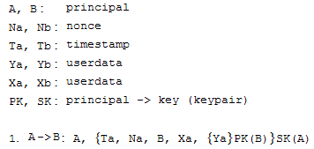
One-Way Authentication
In previous page, I showed an one-way authentication with the following protocol expression:
From CCITT X.509
A의 secret key로 서명함
Reference) http://www.lsv.ens-cachan.fr/Software/spore/ccittx509_1.html
29

Slide 30
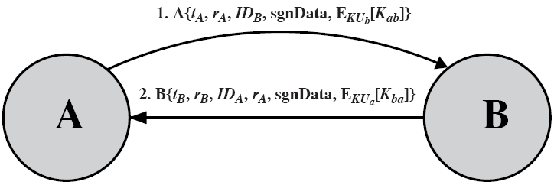
Two-Way Authentication
30
Both parties in a comm to verify the identity of the other
2 messages (A→B, B→A) which also establishes in addition:
  the identity of B and that reply is from B
  that reply is intended for A
  integrity & originality of reply
reply includes original nonce from A, also timestamp and nonce from B

Slide 31
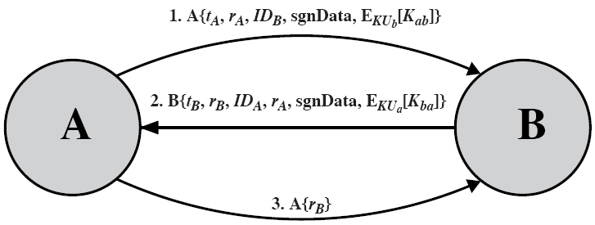
Three-Way Authentication
31
3 messages (A → B, B → A, A → B) which enables above authentication without synchronized clocks
has reply from A back to B containing signed copy of nonce from B
means that timestamps need not be checked or relied upon

Slide 32
X.509 Version 3
32
has been recognised that additional information is needed in a certificate
  email/URL, policy details, usage constraints
rather than explicitly naming new fields defined a general extension method
extensions consist of:
  extension identifier
  criticality indicator
  extension value

Slide 33
Certificate Extensions
key and policy information
  convey info about subject & issuer keys, plus indicators of certificate policy
certificate subject and issuer attributes
  support alternative names, in alternative formats for certificate subject and/or issuer
certificate path constraints
  allow constraints on use of certificates by other CA’s
33

Slide 34
Agenda
X.509 Authentication Service
Public Key Infrastructure
34
Notes:
34

Slide 35
Contents
35
Distribution of Public Keys
  Four options
Public Key Certificate
Public Key Infrastructure
X.509 Certificate
National Certificate Authorities

Slide 36
Distribution of Public Keys
36
The point of public-key cryptography is that the public key is public.
But how can we publish our public key?
Four possible ways
  Public announcement
  Publicly available directory
  Public-key authority
  Public-key certificates

Slide 37
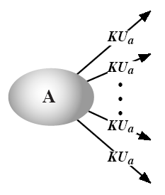
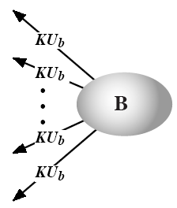
Distribution of Public Keys
1. Public Announcement
Uncontrolled public key distribution
  If there is some broadly accepted public-key algorithm, such as RSA, any participant can send or broadcast his or her public key.
KU_{x} : X’s public key
37

Slide 38
Distribution of Public Keys
1. Public Announcement
38
Example
  PGP key appended to messages to public forums,
  such as USENET newsgroups and Internet mailing lists
Weakness
  Anyone can forge such a public announcement.
  Some user could pretend to be user A and send a public key.
  Until user A discovers the forgery and alerts to other participants, the forger is able to read all encrypted messages intended for A and can use the forged key for authentication.

Slide 39
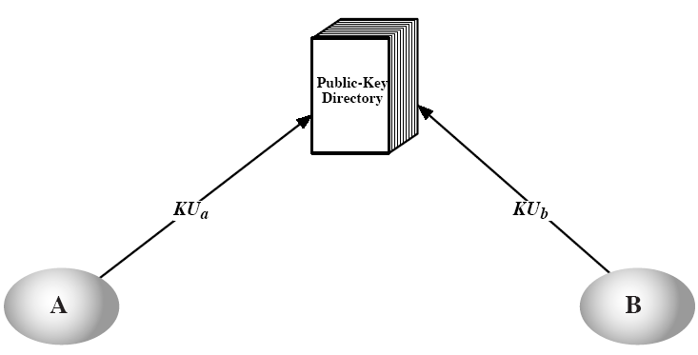
Distribution of Public Keys
2. Publicly Available Directory
KU_{x} : X’s public key
39
Register public keys with a public directory.

Slide 40
Distribution of Public Keys
2. Publicly Available Directory
40
Maintenance and distribution of the public directory is the responsibility of some trusted entity of organization.
More secure than individual public announcements
But still has vulnerabilities.

Slide 41
Distribution of Public Keys
3. Public Key Authority
41
Tighter control over the distribution of public keys from the directory
  A central authority maintains a public key directory.
Assumption
  Each participant reliably knows a public key for the authority.

Slide 42
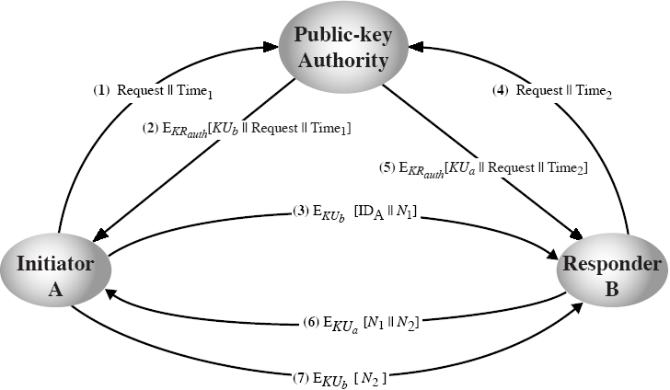
Distribution of Public Keys
3. Public Key Authority
Time₁, Time₂: Timestamps
KR_{x} : X’s private key
KU_{x} : X’s public key
N₁, N₂: Nonces
(random numbers)
(Signature of Auth.)
(Signature of Auth.)
ID_{x} : X’s ID
42

Slide 43
Distribution of Public Keys
3. Public Key Authority
43
Drawback
  The public key authority could be a bottleneck in the system.
  A user must appeal to the authority for a public key for every other user that it wishes to contact.

Slide 44
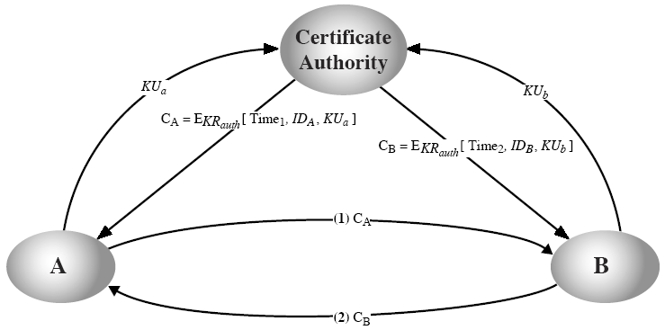
Distribution of Public Keys
4. Public Key Certificates
44

Slide 45
Public Key Infrastructure
45
Public Key Certificate
  public key information that has been signed by the certificate authority (CA).
Public Key Infrastructure (PKI)
  “공개키 기반 구조”
  A framework consisting of policies defining the rules under which the cryptographic systems operate and procedures for generating and publishing keys and certificates.
  All PKIs consist of certification and validation operations.
    Certification binds a public key to an entity.
    Validation guarantees that certificates are valid.

Slide 46
X.509 Certificates
46
ITU-T recommendation X.509 is part of the X.500 series of recommendations that define a directory service.
  ITU: International Telecommunications Union
  ITU-T: ITU Telecommunication Standardization Sector
Directory service
  a software application, or set of applications
  stores and organizes information about a network and its resources, e.g., users, files, printers, servers, and applications.
  allows administrators to manage access to these resources.
  provides transparency in regard to the network structure and the location of these resources.
  Information is usually replicated between directory servers.

Slide 47
* X.500 Directory Service
47
Directory server examples
  NIS (Sun Microsystems)
    the Network Information Service
    originally named as Yellow Pages
  Red Hat Directory Server (Red Hat)
    runs on top of Red Hat Enterprise Linux
  Active Directory (Microsoft)
    included in Windows 2000 and Windows Server 2003.

Slide 48
X.509 Certificates
48
X.509 defines a framework for the provision of authentication services by the X.500 directory to its users.
The directory may serve as a repository of public key certificates.
X.509 is an important standard.
  The certificate structure and authentication protocols defined in X.509 are used in various contexts.
  S/MIME, IP Security, SSL/TLS, SET, …
The standard does not dictate the use of a specific algorithm but recommends RSA.

Slide 49
X.509 Certificates – 이전 내용 참고
49
issued by a Certificate Authority (CA), containing:
  version (1, 2, or 3)
  serial number (unique within CA) identifying certificate
  signature algorithm identifier
  issuer X.500 name (CA)
  period of validity (from - to dates)
  subject X.500 name (name of owner)
  subject public-key info (algorithm, parameters, key)
  issuer unique identifier (v2+)
  subject unique identifier (v2+)
  extension fields (v3)
  signature (of hash of all fields in certificate)

Slide 50
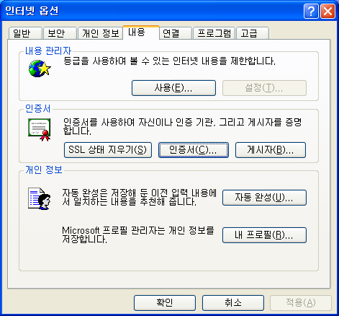
X.509 Certificates: Examples
MS Internet Explorer
→ Tools(도구)
→ Internet Options
(인터넷 옵션)
→ Content(내용)
→ Certificate(인증서)
50

Slide 51
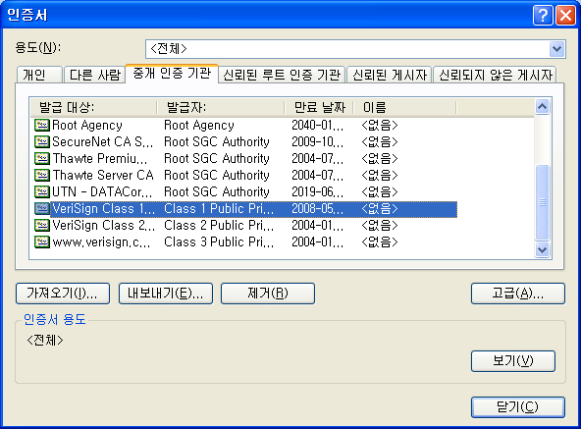
X.509 Certificates: Examples
51

Slide 52
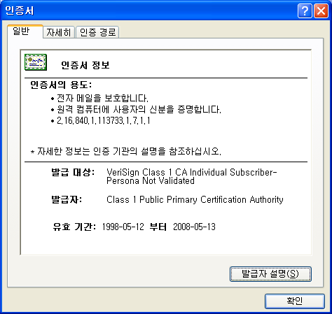
X.509 Certificates: Examples
52

Slide 53
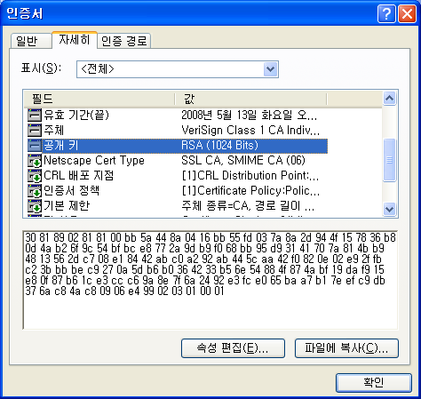
X.509 Certificates: Examples
control symbols
n = pq
e = 65537
53

Slide 54
Certificate Authority
54
Certificate Authority
  It is assumed that CAs are trustworthy.
  Example CAs: Verisign, GTE, Microsoft, …
Notation CA<<A>> denotes certificate for A signed by CA.

Slide 55
Certification Hierarchy
55
It is unlikely that a single CA could ever keep track of and issue every Internet user’s public keys.
Instead, PKIs often consist of multiple CAs that are allowed to certify each other and the certificates they issue.
Complex “trust relationships,” or “chain or trust.”

Slide 56
Certification Hierarchy
56
Suppose that CA X1 has certified A and CA X2 has certified B.
If A does not securely know the public key of X2, then B’s certificate issued by X2 is useless to A.
  A can read B’s certificate, but A cannot verify the signature.
However, if the two CAs (X1 and X2) have securely exchanged their own public keys, it is possible for A to obtain B’s public key.
  A obtains X1<<X2>> from the directory.
  Because A knows X1’s public key, A can obtain X2’s pub. key.
  A goes back to the directory and obtains X2<<B>> .

Slide 57
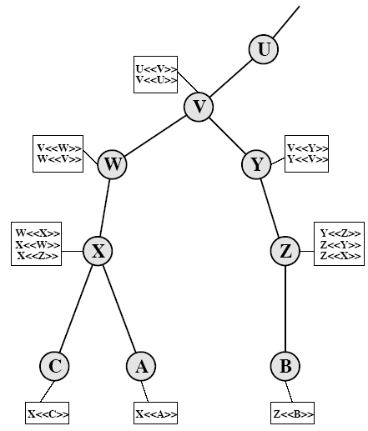
Certification Hierarchy
A has used a chain of certificates to obtain B’s public key.
X.509 suggests that CAs be arranged in a hierarchy so that navigation is straightforward.
A can acquire B’s public key by
X<<W>> W<<V>> V<<Y>>
Y<<Z>> Z<<B>>
57

Slide 58
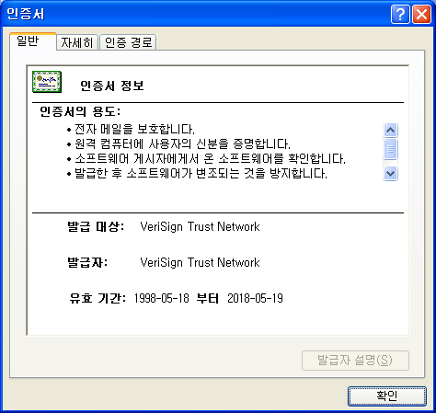
Root CA
CA certifies itself.
CA’s certificates are packaged into your web browser.
You have to trust your computer vendor!!
Don’t buy used computers from your enemies!!
58

Slide 59
Certificate Revocation
59
Certificates have a period of validity
It may need to revoke before expiry, e.g.:
  The user's private key is compromised.
  The user is no longer certified by this CA.
  The CA's certificate is compromised.
Each CA maintains a list of revoked certificates.
  Certificate Revocation List (CRL)
Users should check certificates with CA’s CRL.
Check ‘CRL Distribution Points’ field in a certificate.

Slide 60
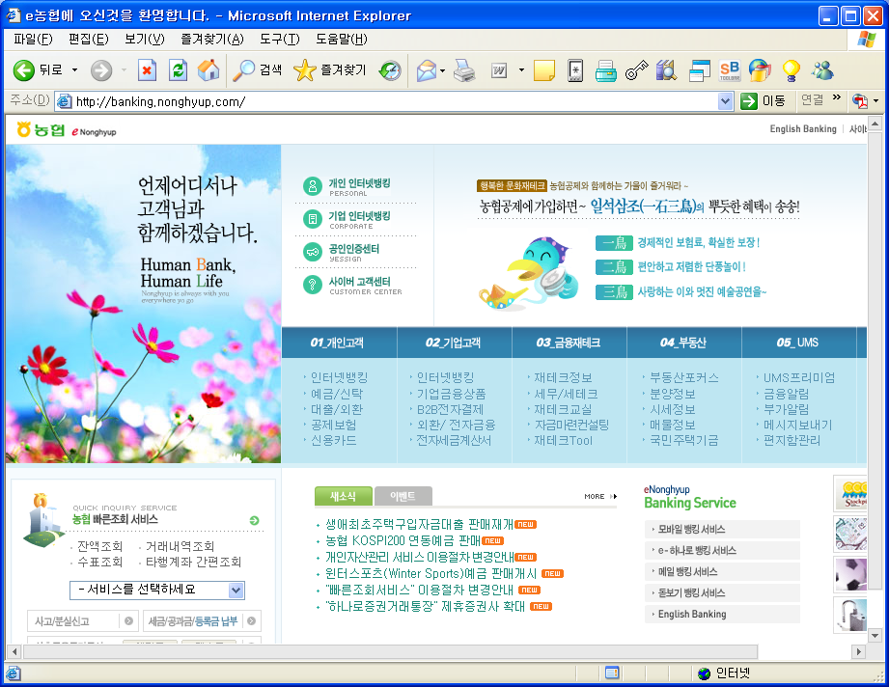
공인인증서
60

Slide 61
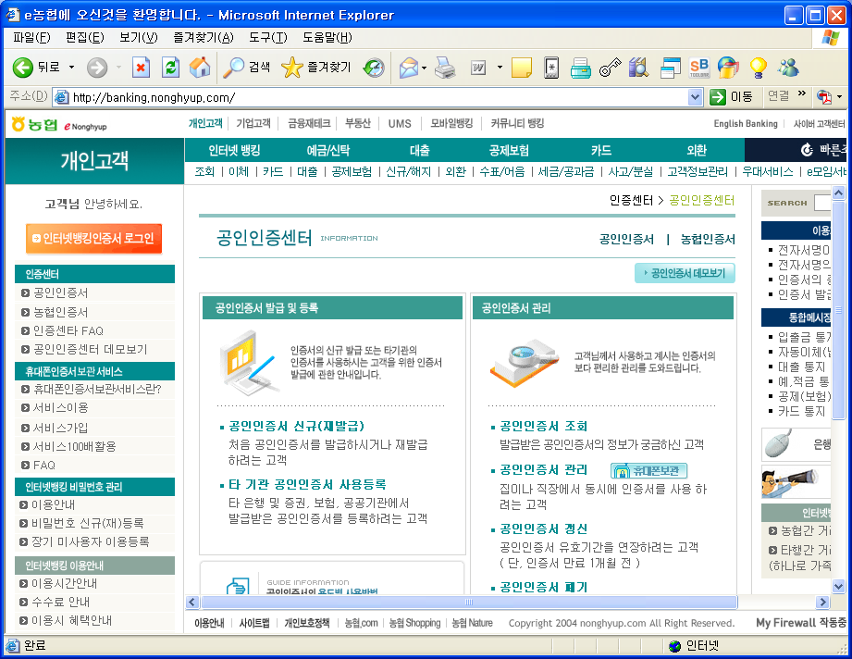
공인인증서
61

Slide 62
공인인증기관
62
전자서명법
  공인인증기관의 지정, 취소, 관리 등에 대해 명시
전자서명법 제4조의 규정에 의하여 지정된 공인인증기관
  한국정보인증(주) http://www.signgate.com
  (주)코스콤 http://www.signkorea.com
  금융결제원 http://www.yessign.or.kr
  한국전산원 http://sign.nca.or.kr
  한국전자인증(주) http://gca.crosscert.com
  한국무역정보통신 http://www.tradesign.net

Slide 63
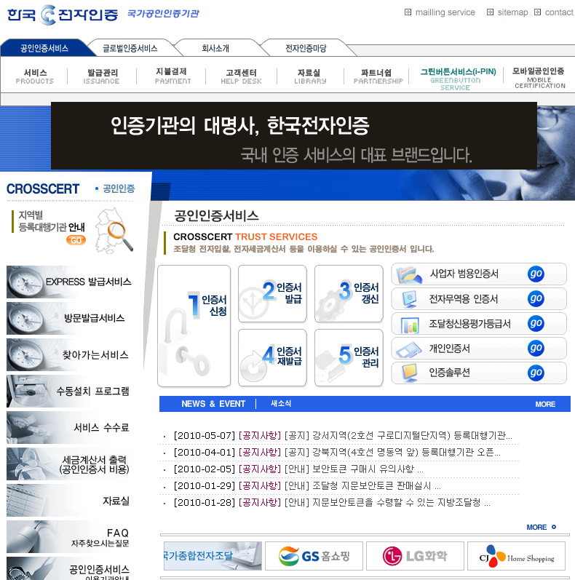
공인인증 vs. 국제인증(공인인증)
http://www.crosscert.com
63

Slide 64
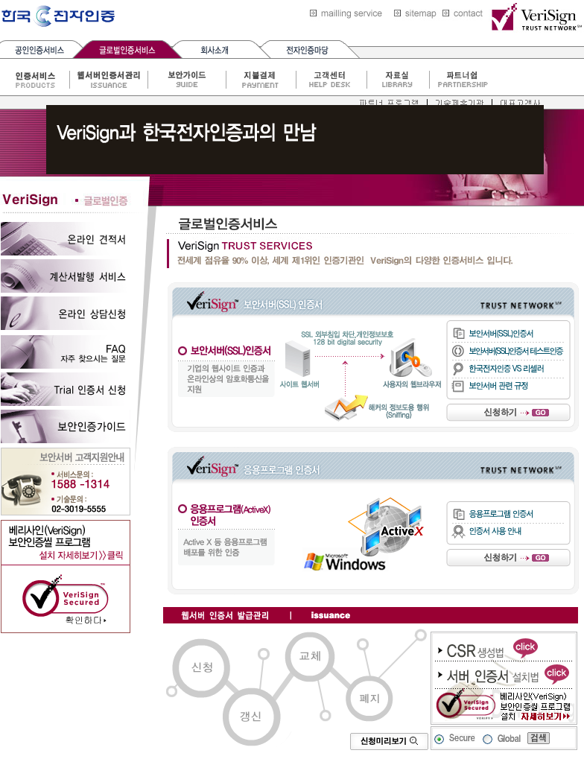
공인인증 vs. 국제인증(글로벌인증)
64

Slide 65
전자서명인증관리센터
65
KCAC (Korea Certification Authority Central)
한국정보보호진흥원(KISA) 산하
전자서명을 안전하고 신뢰성있게 이용할 수 있는 환경을 조성하고 공인인증기관을 효율적으로 관리하기 위해 전자서명법 제 25조에 근거하여 1999년 7월 7일부터 업무개시
주요 업무
  공인인증기관에 대한 공인인증서 발급ㆍ관리 등 인증업무
  공인인증기관 실질심사 및 정기점검
  전자서명인증 관련 기술개발ㆍ보급
  전자서명인증 관련 제도 연구 및 상호인정 등 국제협력 지원
  전자서명 이용활성화 추진

Slide 66
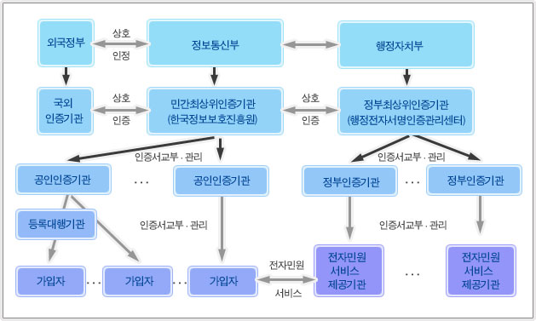
전자서명인증관리센터
66

Slide 67
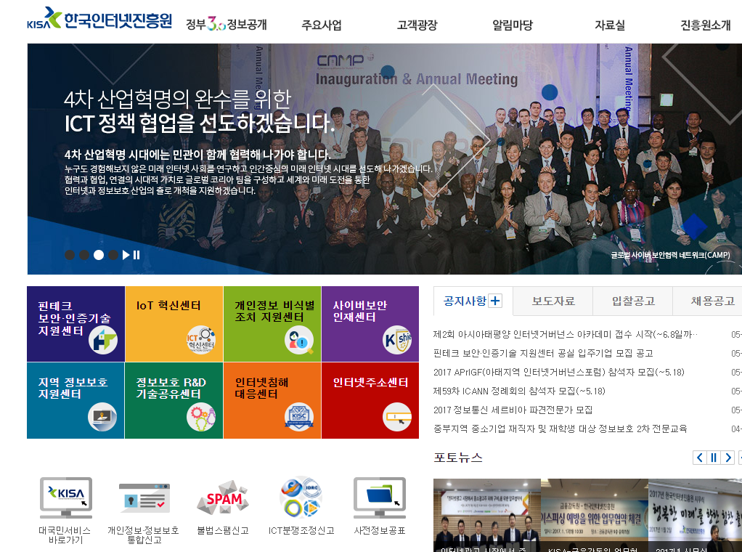
* 한국인터넷진흥원
http://www.kisa.or.kr/
67

Slide 68
* 한국인터넷진흥원
68
Korea Information Security Agency (KISA:한국정보보호진흥원) → Korea Internet & Security Agency (KISA: 한국인터넷 진흥원)
1995년 8월 설립
주요 업무
  정보보호 정책 및 제도 조사, 연구
  정보보호 기술 개발, 시험, 평가
  정보보호 관련 표준 연구
  정보보호 관련 홍보 및 교육, 기술 자문
  전자서명 인증 관리
  개인정보보호 대책 연구
  침해사고 처리 및 대응체계 운영

Slide 69
* 한국인터넷진흥원 주요사업
69
인터넷침해사고대응지원센터 (KrCERT/CC) www.krcert.or.kr/
불법스팸대응센터 (Spam Response Center)
개인정보침해신고센터/개인정보분쟁조정위원회
전자서명인증관리센터 (KCAC)
정보보호관리체계인증 (ISMS: Information Security Management System): 통신사업자, 쇼핑몰, 포털, IDC 등 대상.
정보보호안전진단지원 (ISCS: Information Security Check Service) : 통신사업자, 쇼핑몰, 포털, IDC 등 대상.
보안성평가센터 (KISEC: Korea IT Security Evaluation Center)
: 정보보호제품 안전성 평가
정보보호산업지원센터 (KISIS: Korea Information Security Industry Support Center)

