Slide 1
Discrete Math II
Howon Kim
2019. 9

Slide 2
Agenda
1 Algebra, group, ring
2 Modular arithmetic
3 Euclidean algorithm

Slide 3
Algebra
Definition
  Tuple <K, op₁, op₂, …, op_{n}>
    < R, +, −, ×, ÷ >
    < {T,F }, ∧, ∨, ¬ > ; Boolean algebra
K : a set of data
  |K| : order
  finite or infinite
Operator op_{j}
  Closure op_{j} : K^{i} ➔ K
    Unary if i=1, Binary if i=2, …
3

Slide 4
Identity and Zero
4
⊕ : K × K → K
  Identity element e for ⊕ in K (항등원)
    e ⊕ a = a ⊕ e = a for all a ∈ K
  Zero element z for ⊕ in K (영원)
    z ⊕ a = a ⊕ z = z for all a ∈ K
Examples
  < Z, + >
    Identity : 0, Zero : none
  < Z, × >
    Identity : 1, Zero : 0

Slide 5
Inverse
5
⊕ : K × K → K
  Let e be the identity element for ⊕ in K.
  Left inverse
    a’_{L} ⊕ a = e , a ∈ K
  Right inverse
    a ⊕ a’_{R} = e , a ∈ K
  If a’_{L} = a’_{R} = a’ , a’ is the inverse of a.
Example < Z, + >
    Identity 0,
    (-x) is the inverse of x : x + (-x) = (-x) + x = 0

Slide 6
Properties of Operator
  Let ⊕ : K × K → K be a binary operator.
  (1) Closure
  (2) Associative
    (a ⊕ b) ⊕ c = a ⊕ (b ⊕ c) for all a, b, c ∈ K.
  (3) Identity
    There is an identity element e ∈ K for ⊕.
  (4) Inverse
    For each a ∈ K, there is an inverse a’ ∈ K for ⊕.
  (5) Commutative
    a ⊕ b = b ⊕ a for all a,b ∈K.
6

Slide 7
Binary Algebra
  < K, ⊕ > for binary operator ⊕ : K × K → K
  Semigroup (반군) : Associative
    < Z⁺, + >
    A semigroup is a set with an associative binary operation which satisfies closure and associative law.
  Monoid (단위반군) : Associative, Identity
    < N, + >, < Z, × >, < {T,F }, ∧ >
    A monoid is a set that is closed under an associative binary operation and has an identity element
  Group (군) : Associative, Identity, Inverse
    < Z, + >
  Abelian group (대수군) :
    Associative, Identity, Inverse, Commutative
    < Z, + >
7

Slide 8
Binary Algebra
< K, ⊕ >
Set
(1), (2)
Properties
Closure
Associative
Identity
Inverse
Commutative
Semigroup
Abelian
Semigroup
(5)
(3)
Monoid
Abelian
Monoid
(5)
(4)
Group
Abelian
Group
(5)
8

Slide 9
Binary Algebra
Set
Closure
Semigroup
Associative
Abelian Semigroup
Monoid
Identity
Abelian Monoid
Abelian Group
Group
Inverse
Commutative
9

Slide 10
Ring ( Two operators )
< K, ⊕, ⊗>
  Two binary operators ⊕, ⊗ : K × K → K
Conditions for Ring
  < K, ⊕> is an abelian group.
  ⊗ is associative
  ⊗ is distributive over ⊕
    a ⊗ (b ⊕ c) = (a ⊗ b) ⊕ (a ⊗ c) and
    (a ⊕ b) ⊗ c = (a ⊗ c) ⊕ (b ⊗ c)
    for all a,b,c ∈ K.
10

Slide 11
Definitions
< K, ⊕, ⊗>
  < K, ⊕> : abelian group, and distribution laws hold
Conditions for operator ⊗ :
  Ring (환) : Associative
  Ring with Unity : Associative, Identity
  Commutative Ring : Associative, Commutative
  Commutative Ring with Unity
    Associative, Identity, Commutative
  Field (체)
    Associative, Identity, Commutative, Inverse
11

Slide 12
Ring and Field
< K, ⊕, ⊗>
Set
(0), (1), (2)
Properties for ⊗
  (0) Distributive
  (1) Closure
  (2) Associative
  (3) Identity
  (4) Inverse
  (5) Commutative
Ring
Commutative
Ring
(5)
(3)
(3)
Ring
with Unity
Commutative
Ring with Unity
(5)
(4)
Field
12

Slide 13
Ring and Field
< K, ⊕, ⊗>
Closure
Distributive
Ring
Associative
Field
Ring with Unity
Commutative Ring
Inverse
Identity
Commutative
Ring with Unity
Commutative
13

Slide 14
Example: Square Matrix
Distributive ⊗ over ⊕
For the first operation, it is an Abelian group, and for the second operation, there is a identity (also it is closed and associative)
→ “Ring with unity”
14
< K, ⊕, ⊗>
  K : a set of n × n matrix
  ⊕ : matrix addition
  ⊗ : matrix multiplication
< K, ⊕>
  Closure, Associative, Identity (zero matrix),
  Inverse, Commutative ➔ Abelian Group
< K, ⊗>
  Closure, Associative, Identity
  Not Commutative, Not Inverse

Slide 15
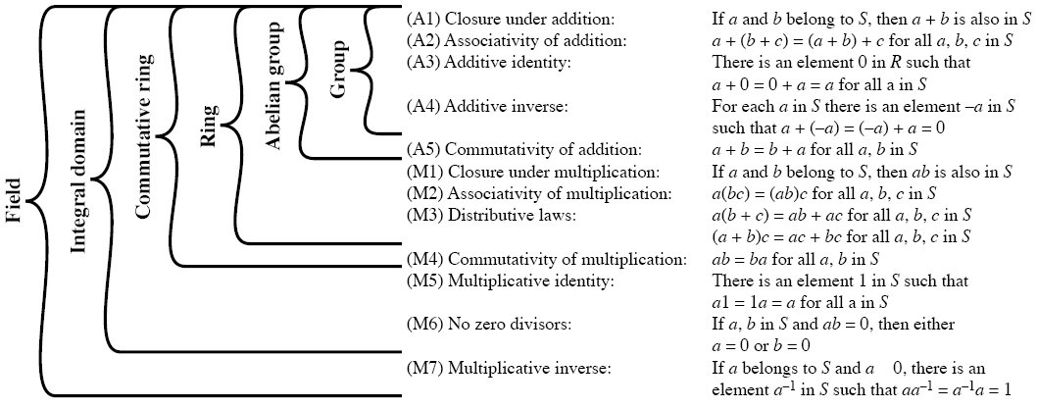
Group/Ring/Integral Domain/Field
In this case, the first operation is “addition” and the second one is “multiplication”
15

Slide 16
Example: Ring and Field
(Note) Inverse
For nonzero
elements
16
Rings for < K, ⊕, ⊗>
  ⊕ : ordinary addition
  ⊗ : ordinary multiplication
  K : 정수, 유리수, 실수 , 복소수
    < Z, +, · >, < Q, +, · >, < R, +, · >, < C, +, · >
Ring but not Field (정수)
  < Z, +, · > : not Inverse for ·
Field (유리수, 실수, 복소수)
  < Q, +, · >, < R, +, · >, < C, +, · >

Slide 17
Agenda
1 Algebra, group, ring
2 modular arithmetic
3 Euclidean algorithm
17
Notes:
17

Slide 18
Congruence Modulo n
Definition
  Let n ∈ Z⁺, n > 1. For a,b ∈ Z, we say that a is congruent to b modulo n, and
  we write a ≡ b (mod n), if n|(a-b), or equivalently, a = b + kn for some k ∈ Z.
  17 ≡ 2 (mod 5) ; 17 = 2 + 3⋅5
  -7 ≡ -49 (mod 6) ; -7 = -49 + 7⋅6
Theorem 1
  Congruence modulo n is an equivalence relation on Z.
(note) m|n : m divides n, for m,n ∈ Z, m ≠ 0
18

Slide 19
Equivalence Classes
  Note that an equivalence relation on a set induces a partition of the set.
  Congruence modulo n (≥ 2) partitions Z into the n equivalence classes.
  [0] = { 0+nx | x∈Z } = {.., -n, 0, n,..}
  [1] = { 1+nx | x∈Z } = {.., 1-n, 1, 1+n,..}
  [2] = { 2+nx | x∈Z } = {.., 2-n, 2, 2+n,..}
  :
  [n-1] = { (n-1)+nx | x∈Z } = {..,-1, n-1, 2n-1,..}
19

Slide 20
Zn
  For all t ∈ Z, t = qn + r (0 ≤ r < n), so t ∈ [r] or [t] = [r].
Zn = { [0], [1],..., [n-1] }
  Two closed operators on Zn : + and ⋅
  [a] + [b] = [a+b] and [a]⋅[b] = [a][b] = [ab]
  For n = 7, [2] + [6] = [2+6] = [8] = [1],
  and [2][6] = [12] = [5].
20

Slide 21
Zn , n=7
21
...
-21 -20 -19 -18 -17 -16 -15
-14 -13 -12 -11 -10 -9 -8
-7 -6 -5 -4 -3 -2 -1
0 1 2 3 4 5 6
7 8 9 10 11 12 13
14 15 16 17 18 19 20
21 22 23 24 25 26 27
28 29 30 31 32 33 34
...

Slide 22
Zn is a field ?
Theorem 2
  For n ∈ Z⁺, n > 1, under the two closed operators, Zn is a commutative ring with unity [1] (and additive identity [0] ).
  (Ex.) < Z₅,+,⋅ >
➔ Field
+
0
1
2
3
4
⋅
0
1
2
3
4
0
0
1
2
3
4
0
0
0
0
0
0
1
1
2
3
4
0
1
0
1
2
3
4
2
2
3
4
0
1
2
0
2
4
1
3
3
3
4
0
1
2
3
0
3
1
4
2
4
4
0
1
2
3
4
0
4
3
2
1
(Note) Inverse : for nonzero elements
22

Slide 23
continue
  (Ex.) < Z₆, +, ⋅ >
➔ Not Field
+
0
1
2
3
4
5
⋅
0
1
2
3
4
5
0
0
1
2
3
4
5
0
0
0
0
0
0
0
1
1
2
3
4
5
0
1
0
1
2
3
4
5
2
2
3
4
5
0
1
2
0
2
4
0
2
4
3
3
4
5
0
1
2
3
0
3
0
3
0
3
4
4
5
0
1
2
3
4
0
4
2
0
4
2
5
5
0
1
2
3
4
5
0
5
4
3
2
1
proper divisors of zero
Unit
23

Slide 24
Unit
Definition
24

Slide 25
Zn with a prime n
Theorem 3
  Zn is a field if and only if n is a prime.
  ( proof of ← )
  Let n is a prime, and suppose that 0 < a < n. Then gcd(a,n) = 1, so as we learned that there are integers s,t with as + tn = 1.
  Thus as ≡ 1 (mod n), or [a][s] = [1]. Since [a] is a unit of Zn, which is a consequently a field.
25

Slide 26
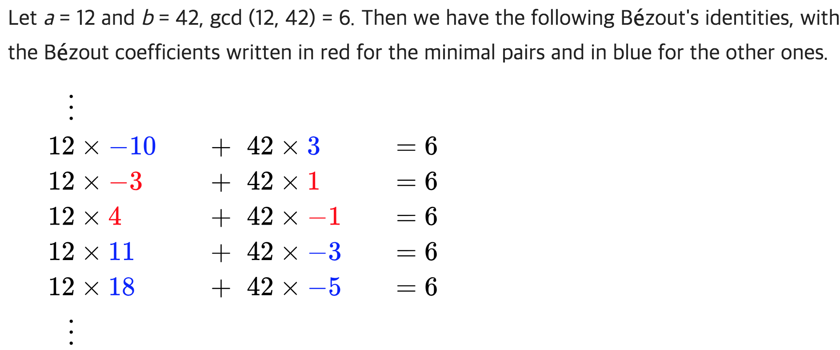
Zn with a prime n
(Note 1) as + bt = gcd(a,b)← Text p. 231 (Theorem 4.6): Bezout’s identity
For all a,b ∈ Z⁺, the following equation is satisfied. 단, s,t는 유일하지 않음
gcd(a,b) = as + bt, for some s,t ∈ Z
Reference) Wikipedia
(Note 2) Unit
The element that has the multiplicative inverse, in a ring with unity
26

Slide 27
Zn with a prime n
Theorem 3
  Zn is a field if and only if n is a prime.
  ( proof of ← )
  If n is not a prime, then n =n₁*n₂, where 1<n₁,n₂<n. So [n₁]!=[0] and [n₂]!=[0] but [n₁][n₂]=[n₁*n₂]=[0] (can be), and Z_{n} is not even an integral domain. So it cannot be a field.
(Note) Integral domain: no zero divisor + commutative ring
No zero divisor :
if a,b in S and a*b=0, then either a=0 or b=0
27

Slide 28
Zn with a prime n
Theorem 3
  Zn is a field if and only if n is a prime.
  ( proof of → )
  if Zn is a field, [a] is a unit for 0 < a < n. Then there is the s (0 < s < n) such that [a][s] = [1]. So as ≡ 1 (mod n) and as = 1 + tn.
  Then, as + (-t)n = 1 that is the smallest number among { ax+ny | x,y ∈ Z, ax+ny > 0 }
  Therefore, gcd(a,n) = 1 and n is a prime.
0보다 큰 수 중에서 가장 작은 값은 1이며,
Bezout’s identity에 의해 1인 경우, gcd(a,n)=1이 됨.
이는 n이 prime 임을 의미함
28

Slide 29
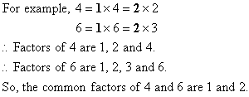
Unit in Zn
a와n이 common factor가 없다는 것은 서로소라는 의미
Theorem 4
  In Zn, [a] is a unit if and only if gcd(a,n) = 1.
  ( proof 1)
곱셈에 대한 역원가짐
→
←
29

Slide 30
Unit in Zn
Theorem 4
  In Zn, [a] is a unit if and only if gcd(a,n) = 1.
  ( proof 2)
  gcd(a,n) = 1 = as + tn, for some s,t ∈ Z. Then, as = 1 - tn and [a][s] = [1]. So [a] is a unit.
  Let [a] ∈ Zn and [a]⁻¹ = [s]. Then [as] = [a][s] = [1], so as ≡ 1 (mod n) and as = 1 + tn, for some t ∈ Z. Therefore, gcd(a,n) = 1.
곱셈에 대한 역원가짐
←
→
gcd(25,72)=1
(Ex) Find [25]⁻¹ in Z₇₂.
1 = (-23)25 + 8(72) ⇒ (-23)(25) ≡ 1 (mod 72)
Therefore, [25]⁻¹ = [-23] = [-23+72] = [49]
not a prime number
30

Slide 31
Unit in Zn
  (Ex.) < Z₆, +, ⋅ >
➔ Not Field
n
But gcd(5,6) = 1.
1 = (5)(5)+(-4)(6),
so [5]⁻¹ = [5].
⋅
0
1
2
3
4
5
0
0
0
0
0
0
0
1
0
1
2
3
4
5
2
0
2
4
0
2
4
3
0
3
0
3
0
3
4
0
4
2
0
4
2
gcd(2,6) ≠ 1,
gcd(3,6) ≠ 1,
gcd(4,6) ≠ 1.
5
0
5
4
3
2
1
a
proper divisors of zero
31

Slide 32
Euler’s Phi Function
32
complete set of residues is: 0..n-1
reduced set of residues, in which those numbers (residues) are relatively prime to n
  eg for n=10,
  complete set of residues is {0,1,2,3,4,5,6,7,8,9}
  reduced set of residues is {1,3,7,9}
number of elements in reduced set of residues is called the Euler Phi (Totient) Function ø(n)
ø(10)=4 and the set is {1,3,7,9}

Slide 33
Euler’s Phi Function
Definition
  For n ∈ Z⁺ and n ≥ 2, let φ(n) be the number of positive integers m, where 1 ≤ m < n and m,n are relatively prime. This function is known as Euler’s phi function.
  When p₁,...,p_{t} are distinct primes and e_{i} ≥ 1 for all 1 ≤ i < t,
(Note) relatively prime
For m,n ∈ Z⁺ and 1 ≤ m < n, if gcd(m,n) = 1, then m,n are called relatively prime.
33

Slide 34
Examples
φ(72) ?
φ(20) ?
1, 3, 7, 9, 11, 13, 17, 19
34

Slide 35
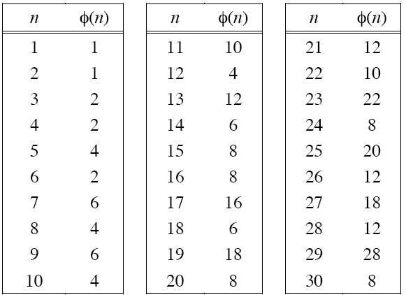
Examples
35

Slide 36
Corollary
Let p is a prime and e ≥ 1.
If n = p^{e}, φ(n) = p^{e-1} (p-1).
If n = p, φ(n) = n-1.
  p=3, e=3인 경우,
    φ(27) = 3² (3-1) = 18, φ(11) = 11 – 1 = 10
If gcd(m,n) = 1, then φ(mn) = φ(m) φ(n).
  m = 10 = 2⋅5, n = 27 = 3³,
  φ(270) = (2-1)(5-1)(3³-3²) = 4⋅18 = φ(10) φ(27)
36

Slide 37
Proof of φ(mn) = φ(m) φ(n)
If gcd(m,n) = 1, then φ(mn) = φ(m) φ(n).
37

Slide 38
Zn* vs. φ(n)
Definition of Zn*
  The set of the equivalence class [m] in Zn such that m is relatively prime to n is called Zn*.
  Zn* = { [m] | gcd(m,n) = 1, 1 ≤ m < n }
  Note that |Zn*| = φ(n).
  Z₁₀* = { 1,3,7,9 }
  φ(10) = φ(2⋅5) = (2-1)(5-1) = 4
  Z₁₅* = { 1,2,4,7,8,11,13,14 }
  φ(15) = φ(3⋅5) = (3-1)(5-1) = 8
reduced set of residues
38

Slide 39
Example of Z₁₅*
Multiplication Table of Z₁₅*
· 1 2 4 7 8 11 13 14
1 1 2 4 7 8 11 13 14
2 2 4 8 14 1 7 11 13
4 4 8 1 13 2 14 7 11
7 7 14 13 4 11 2 1 8
8 8 1 2 11 4 13 14 7
11 11 7 14 2 13 1 8 4
13 13 11 7 1 14 8 4 2
14 14 13 11 8 7 4 2 1
< Z₁₅*, ⋅ >
Abelian Group for multiplication
1) Closed
2) Associative
3) Identity
4) Inverse
5) Commutative
39

Slide 40
Zn vs. φ(n)
In general,
  For any n ∈ Z⁺, n > 1, there are φ(n) units and n-1- φ(n) proper divisors of zero in Zn.
  Z₁₀* = { 1,3,7,9 }
  φ(10) = φ(2⋅5) = (2-1)(5-1) = 4
40

Slide 41
Summary
Zn
Zp
Zn*
Commutative Ring with Unity
Abelian Group for multiplication
Field
φ(n) units
n-1-φ(n) proper divisors of zero
φ(p) = p-1 units
Relatively prime or not
41

Slide 42
Agenda
1 Algebra, group, ring
2 Modular arithmetic
3 Euclidean algorithm
42
Notes:
42

Slide 43
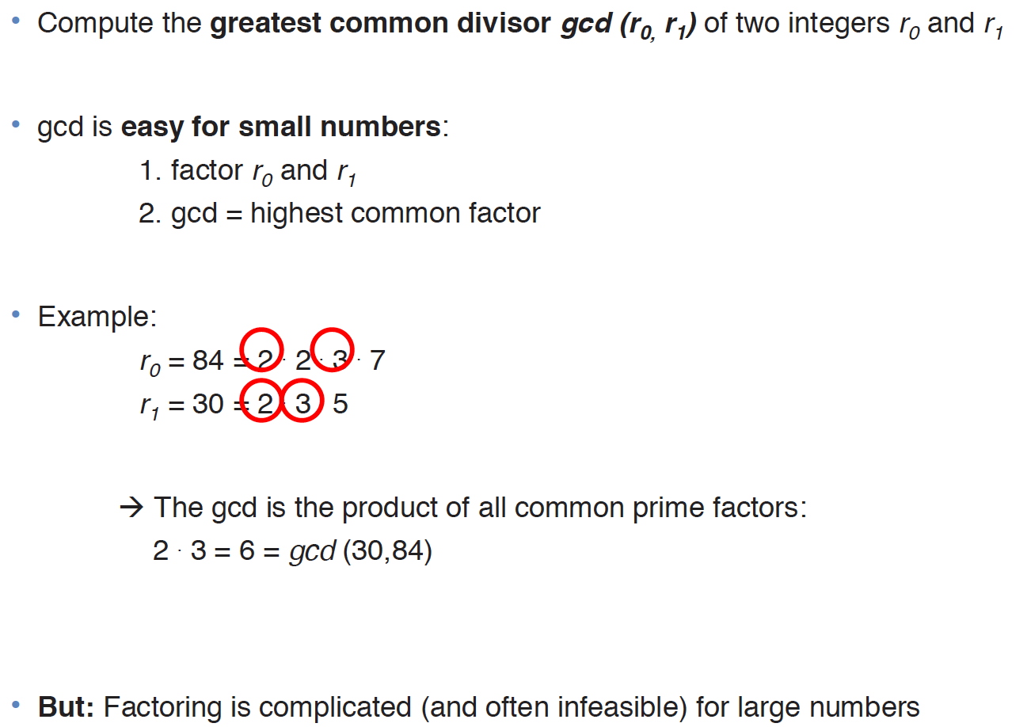
Gcd 구하기
참고 Chapter 6 of Understanding Cryptography by Christof Paar and Jan Pelzl

Slide 44
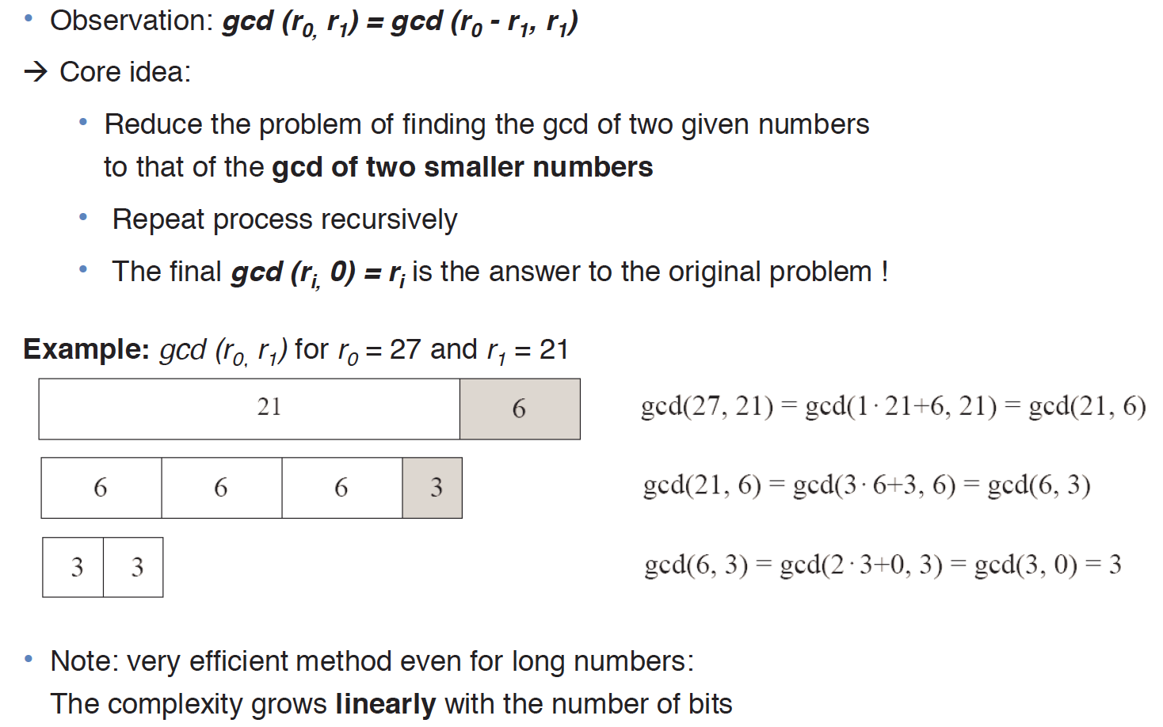
Gcd 구하기: Euclidean Alg 아이디어
r0와 r1의 gcd는, r0-r1과 r1간의 gcd와 동일.
→ r0-r1은 결국 r0을 r1으로 나눠서 몫1, 나머지 r0-r1을 의미함
27을 21로 나눠서 몫 1* 21 + 나머지 6
21을 6으로 나눠서, 몫 3*6 + 3
6을 3으로 나누면, 몫 2*3 + 0

Slide 45
Euclidean Algorithm (1)
Algorithm to find the Greatest Common Divisor
Euclid’s Algorithm is based on the following theorem:
  gcd(a, b) = gcd(b, a mod b)
  Proof:
  Let d=gcd(a,b). Then by definition of gcd, d|a and
  d|b. Also a can be expressed in the form: a = kb + r.
  since a mod b = r, it can be expressed as (a mod b) = a – kb for some k.
  Because d|b, d also divides kb. And d|a. Therefore, d|(a mod b).
  We already know d|b. So by gcd definition, d = gcd(b, a mod b) !
  Conversely, if d = gcd(b, a mod b), then d|kb and thus d|[kb + (a mod b)], which is equivalent to d|a.
  Thus the set of common divisors of a and b is equal to the set of common divisors of b and ( a mod b).
Relatively prime
  a and b are relatively prime if gcd(a, b) = 1.
45

Slide 46
Euclidean Algorithm (2)
46
gcd(a, b) = gcd(b, a mod b)
  gcd(55,22) = gcd(22, 55 mod 22) = gcd(22,11) = gcd(11,0)=11
  gcd(18,12) = gcd(12, 6) = gcd(6, 0) = 6
  gcd(11,10) = gcd(10, 1) = gcd(1, 0) = 1
Euclid's Algorithm to compute GCD(a,b):
  A=a, B=b
  while B>0
    R = A mod B
    A = B, B = R
  return A

Slide 47
Euclidean Algorithm (3)
Recursive Euclidean Algorithm
  Euclid (a,b)
  if b = 0 then return a
  else return Euclid (b, a mod b) fi
  Euclid (76,16) ; 76 = 4x16 + 12
  Euclid (16,12) ; 16 = 1x12 + 4
  Euclid (12,4) ; 12 = 3x4 + 0
  Euclid (4,0) ➔ 4
47

Slide 48
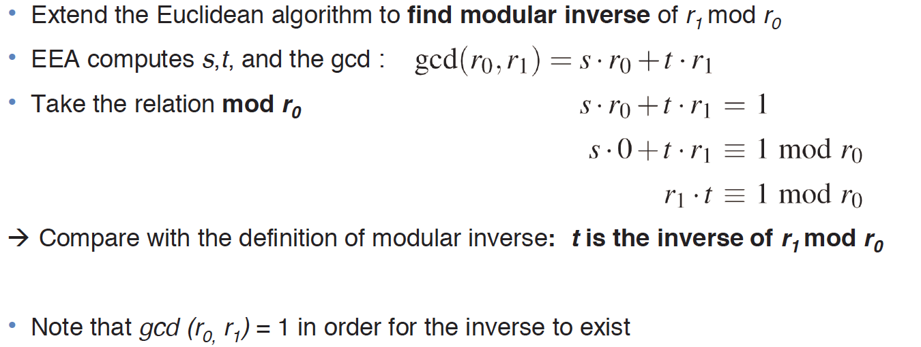
Gcd & Extended Euclidean Algorithm

Slide 49
Finding the Multiplicative Inverse
Extended Euclid algorithm to compute b⁻¹ mod m
  EXTENDED EUCLID(m, b)
  (A₁, A₂, A₃)=(1, 0, m);
  (B₁, B₂, B₃)=(0, 1, b)
  2. if B₃ = 0 return “no inverse” // no inverse
  3. if B₃ = 1 return B₂ // B₂ = b^{–1} mod m
  4. Q = // Q: quotient
  5. (T₁, T₂, T₃)=(A₁ – Q*B₁,
  A₂ – Q*B₂,
  A₃ – Q*B₃)
  6. (A₁, A₂, A₃)=(B₁, B₂, B₃)
  7. (B₁, B₂, B₃)=(T₁, T₂, T₃)
  8. goto 2
If we equate A and B with A₃ and B₃ respectively,
we can get the same Euclidean algorithm as shown previously.
49

Slide 50
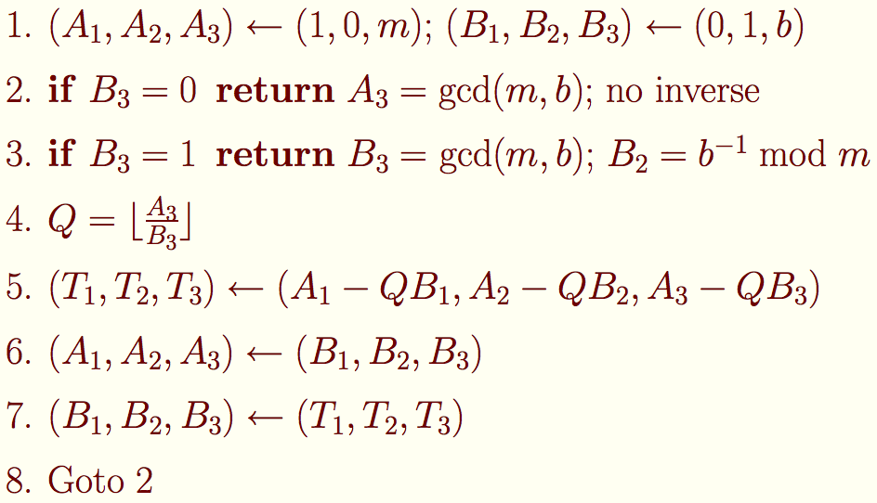
Finding the Multiplicative Inverse
Extended Euclid algorithm to compute b⁻¹ mod m
Throughout the computation, the following relationships hold:
  mT₁+bT₂=T₃
  mA₁+bA₂=A₃
  mB₁+bB₂=B₃
Also, if gcd(m,b)=1 then on the final step, A₃=1 and B₃=0.
Also on the preceding step. B₃=1.
In case of B₃=1,
mB₁+bB₂=B₃
mB₁+bB₂=1
bB₂=1-mB₁
bB₂=1 (mod m)
That is, B₂ ≡ b⁻¹ mod m
50

Slide 51
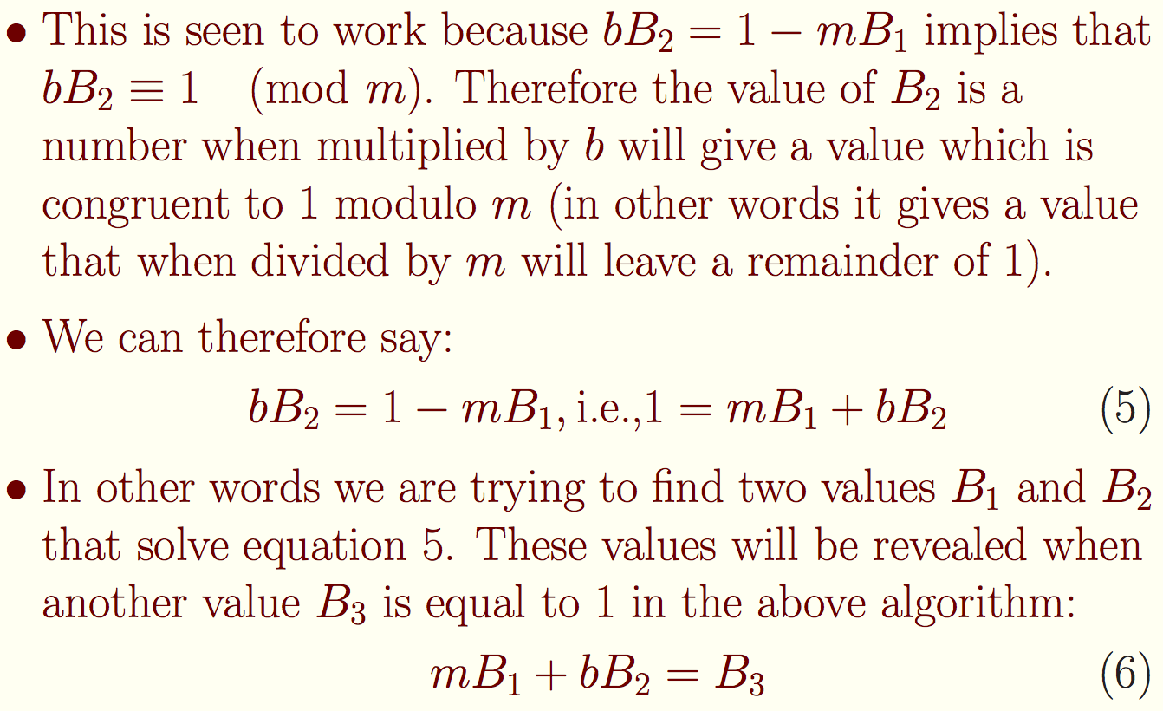
The correctness of Multiplicative Inverse
51

Slide 52
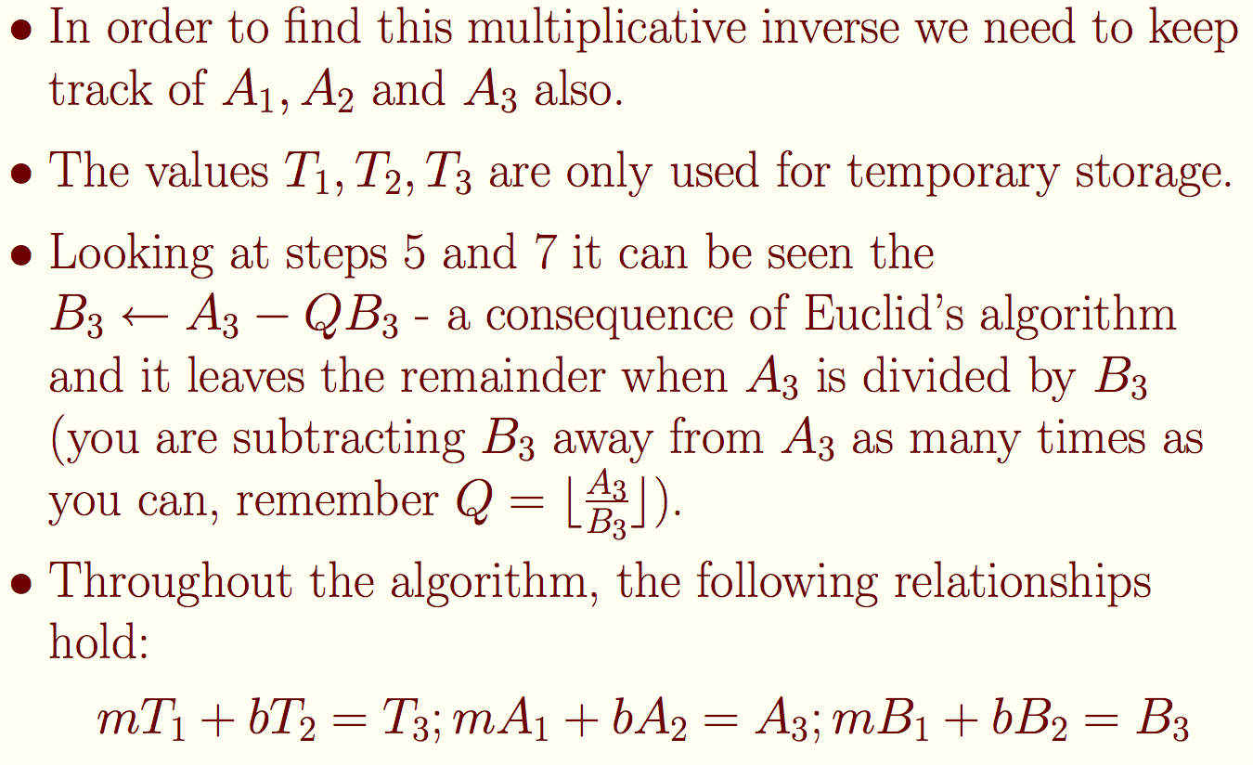
The correctness of Multiplicative Inverse
52

Slide 53
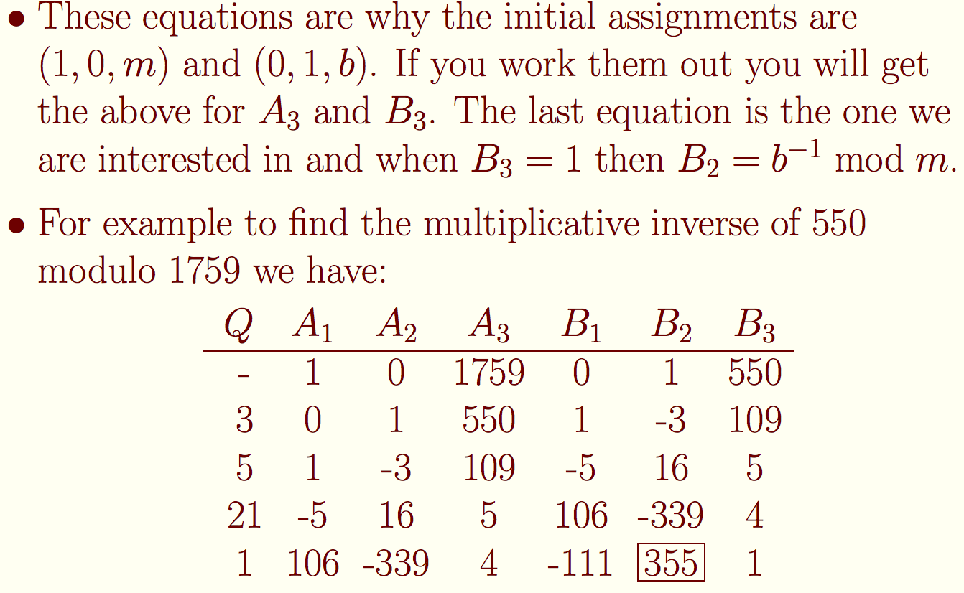
The correctness of Multiplicative Inverse
53

Slide 54
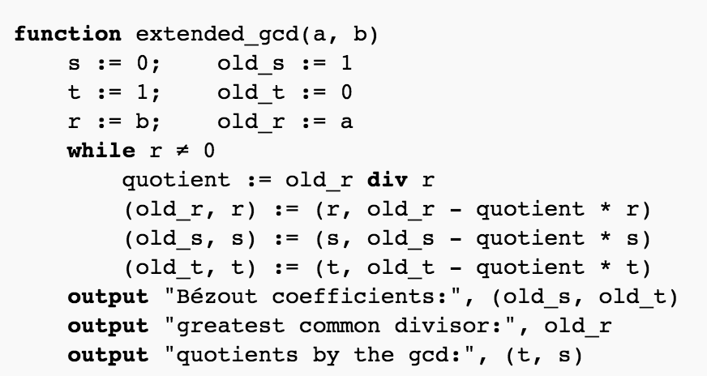
Finding the Multiplicative Inverse
https://en.wikipedia.org/wiki/Extended_Euclidean_algorithm
54

Slide 55
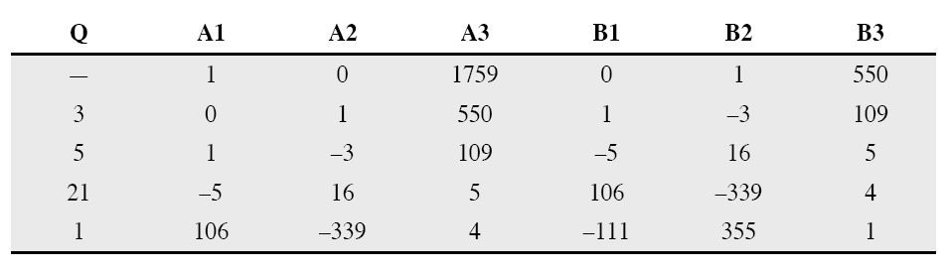
Example: 550⁻¹ mod 1759
55

Slide 56
More on Bezout’s Identity
Euclid’s Algorithm is more useful than simply giving an efficient way to determine the greatest common divisor of two numbers. It also yields a relationship between two numbers and their greatest common divisor that is of great importance, both practically and theoretically, as we shall see. The relationship is called:
Theorem (Bezout’s Identity). If the greatest common divisor of a and b is d, then d = ar+bs for some integers r and s
Solving Bezout’s Identity by Euclid’s Algorithm is often called the Extended Euclidean Algorithm
<참고: A concrete introduction to higher algebra, p.37~>
56

