Slide 1
Internet of Things
디지털 서명 및 인증 프로토콜
Howon Kim
2019.9

Slide 2
Agenda
Public Key Cryptography – basics
Authentication Protocols
  Symmetric Encryption Approaches
  Public Key Encryption Approaches
  One Way Authentication
Kerberos
2
Notes:
2

Slide 3
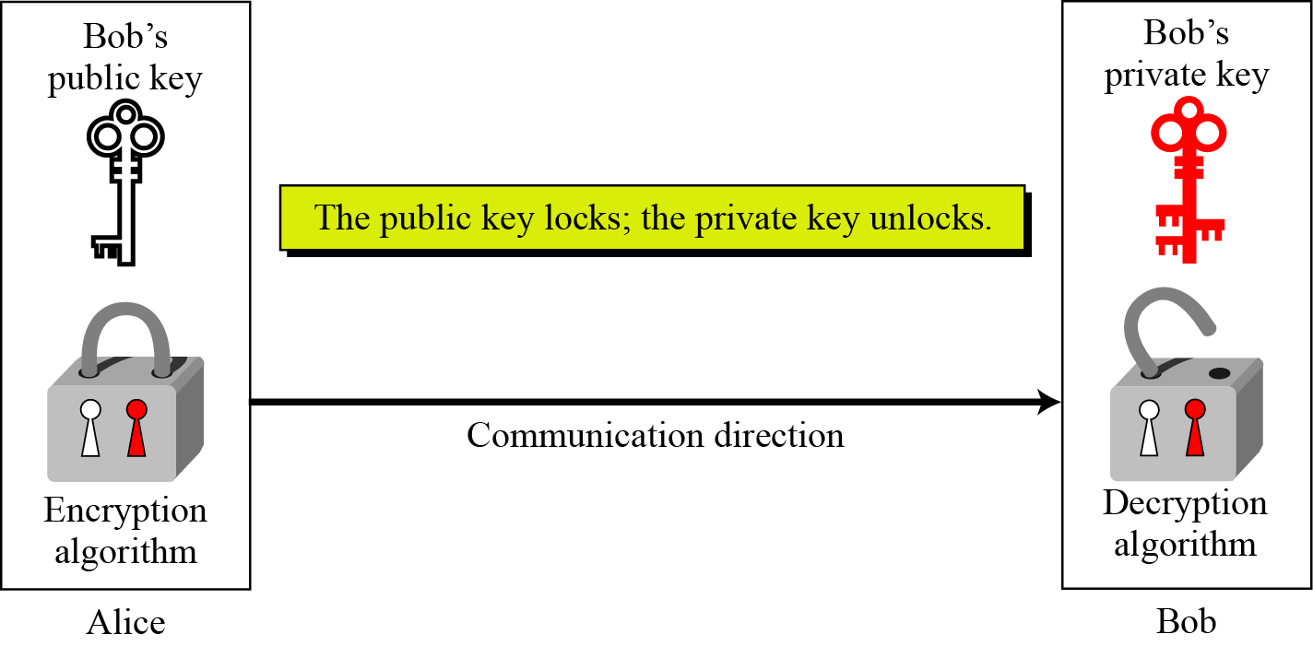
Public-Key Cryptography
Asymmetric key cryptography uses two separate keys: one private and one public.
Notes:
Stallings Fig 9.1

Slide 4
PKC: Encryption / Decryption
Cryptanalyst
PrivB?
M?
Source A
Destination B
Message
Source
M
Encrypt
C
Decrypt
M
Destination
PubB
PrivB
Key-pair
Source
Private key를 아는 사람(B!)만이 이를 해독할 수 있음

Slide 5
PKC: Digital Signature
Cryptanalyst
PrivA?
Source A
Destination B
Message
Source
M
Sign
(M, Sign(M))
or
Sign(M)
Verify
M
Destination
PrivA
PubA
Key-pair
Source
A의 서명에 대한 검증은 A의 공개키로 이뤄짐

Slide 6
Why Public-Key Cryptography?
developed to address two key issues:
  key distribution – how to have secure communications in general without having to trust a KDC with your key
  digital signatures – how to verify a message comes intact (not altered or damaged) from the claimed sender

Slide 7
RSA
by Rivest, Shamir & Adleman of MIT in 1977
best known & widely used public-key scheme
based on exponentiation in a finite (Galois) field over integers modulo a prime
  exponentiation takes O((log n)³) operations (easy)
uses large integers (eg. 1024 bits)
security due to cost of factoring large numbers
  factorization takes O(e ^{log n log log n}) operations (hard)

Slide 8
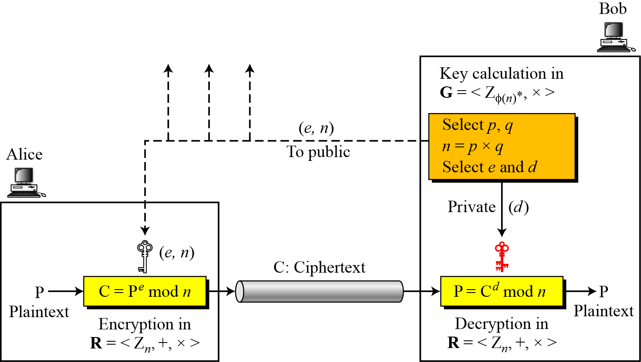
RSA
ed=ø(n)+1 → ed mod ø(n)= 1
Encryption, decryption, and key generation in RSA

Slide 9
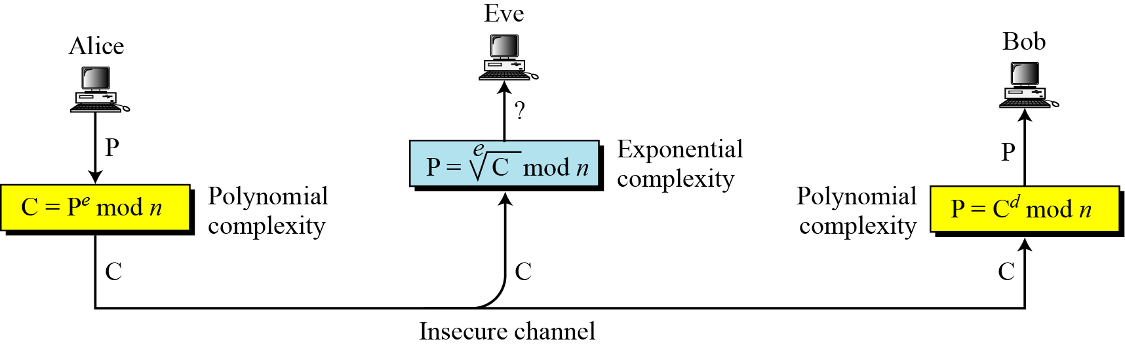
RSA
Complexity of operations in RSA
(attacker)
M
Me
M

Slide 10
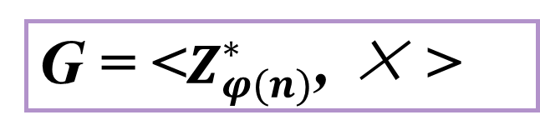
RSA
Two Algebraic Structures
Encryption/Decryption Ring:
R = <Z_{n} , +, × >
G = <$Z_{φ(n)}^{∗}$, × >
Key-Generation Group:

Slide 11
RSA
Plaintext is encrypted in blocks, with each block having a binary value less than some number n
That is, the block size is less than or equal to log₂(n)
The bock size is i bits, where 2^{i} < n <= 2^{i+1}
Encryption is done as follows: (sender)
  computes: C=Me mod n
Decryption is done as follows: (receiver)
  computes: M=C^{d} mod n = (Me)^{d} mod n = M^{ed} mod n
Both sender & receiver must know the value of n
Thus, this is the PKC with public key of PU={e} and a private key of PR={d}
Actually, PR=(d,p,q}

Slide 12
RSA
For this algorithm to be satisfactory for PKC, the following requirements must be met:
  It is possible to find values of e, d, n such that M^{ed} mod n = M for all M < n.
  It is relatively easy to calculate mod Me mod n and C^{d} for all values of M < n.
  It is infeasible to determine d given e and n.
ed=ø(n)+1 → ed mod ø(n)= 1
즉, M^{ø(n)+1}= M 이므로

Slide 13
RSA
It is possible to find values of e, d, n such that M^{ed} mod n = M for all M < n.
  From the euler function, a^{ø(n)+1} = a (mod n), where gcd(a,n)=1, ed=ø(n)+1 → ed mod ø(n)= 1
  This is equivalent to saying. ed = 1 mod ø(n). d=e⁻¹ mod ø(n)
  That is, e and d are multiplicative inverses mod ø(n).
  Note that, according to the rules of modular arithmetic, e is relatively prime to ø(n). that is, gcd(ø(n),e)=1. Also, equivalently, gcd(ø(n),d)=1.
아니면 e는 ø(n)과 약수를 가져서 ed mod ø(n)= 0 이 됨

Slide 14
RSA
Now, we ready to state the RSA scheme
  p,q, two prime numbers → private, chosen
  n = pq → public, calculated
  e, with gcd(ø(n),e)=1; 1<e<ø(n)→ public, chosen
  d=e⁻¹( mod ø(n))→ private, calculated
  ※ Private key PR= {d,p,q},public key PU= {e,n}

Slide 15
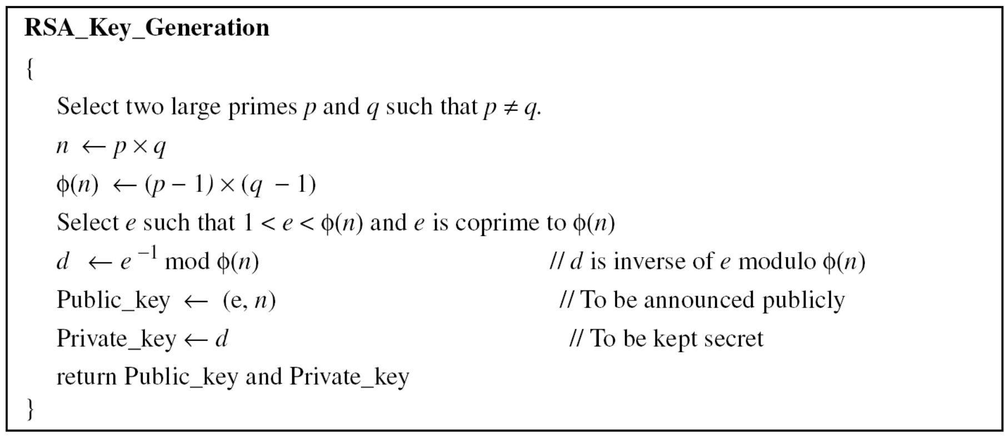
RSA Key Setup

Slide 16
RSA Key Setup - Example
Select primes: p=17 & q=11
Compute n = pq =17×11=187
Compute ø(n)=(p–1)(q-1)=16×10=160
Select e : gcd(e,160)=1; choose e=7
Determine d: de=1 mod 160 and d < 160 Value is d=23 since 23×7=161= 10×160+1
Publish public key PU=(e,n)=(7,187)
Keep secret private key PR=d= 23

Slide 17
RSA En/Decryption
Suppose that A has published its public key, PU= {e,n} and user B wishes to send the message M to A.
Then B calculates C = Me mod n and transmits C. Here, M<n
On receipt of this ciphertext, user A decrypts by calculating M = C^{d} mod n.

Slide 18
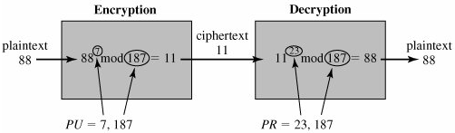
RSA En/Decryption - Example
Example of RSA encryption/decryption.
Key : PU={7,187}, PR={23,17,11}
Given message M = 88 (note, 88<187)
Encryption:
  C = 88⁷ mod 187 = 11
Decryption:
  M = 11²³ mod 187 = 88

Slide 19
Proof of RSA

Slide 20
Agenda
Public Key Cryptography – basics
Authentication Protocols
  Symmetric Encryption Approaches
  Public Key Encryption Approaches
  One Way Authentication
Kerberos
20
Notes:
20

Slide 21
Message Authentication
Has the following limits
  The message authentication protects two parties who exchange messages from any third party
  However, it does not protect the two parties against each other.
    For example, suppose that John sends an authenticated message to Mary,
    Mary may forge a different message and claim that it came from John. (Mary would simply have to create a message and append an authentication code using the key that John and Mary share.)
    Also, John can deny sending the message. (Because it is possible for Mary to forge a message, there is no way to prove that John did in fact send the message)
21

Slide 22
Digital Signatures
That is, the message authentication does not address issues of lack of trust
Digital signatures provide the ability to:
  verify author, date & time of signature
  authenticate message contents
  be verified by third parties to resolve disputes
hence include authentication function with additional capabilities
22
Notes:
22

Slide 23
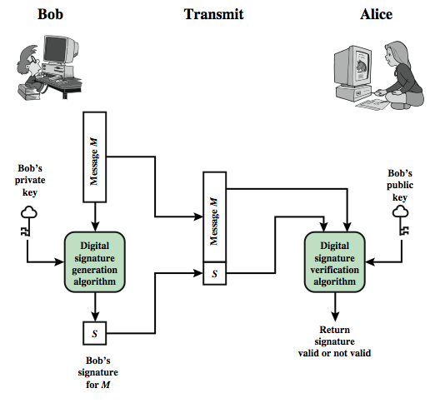
Digital Signature Model
Generic model of digital signature process
23
Notes:
23

Slide 24
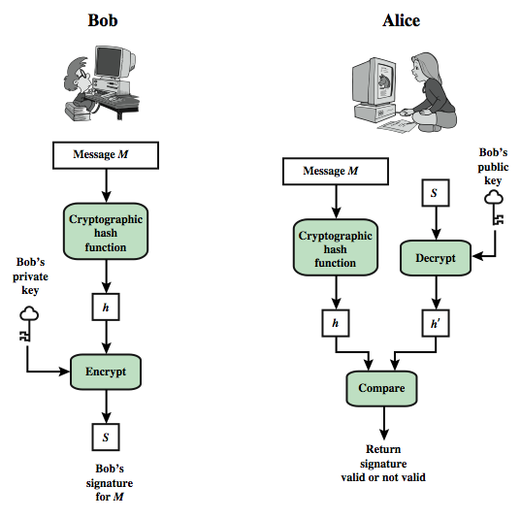
Digital Signature Model
Simplified depiction of essential elements of digital signature process
24
Notes:
24

Slide 25
User Authentication
fundamental security building block
  basis of access control & user accountability
is the process of verifying an identity claimed by or for a system entity
has two steps:
  identification - specify identifier
  verification - bind entity (person) and identifier
distinct from message authentication
Notes:
25
This chapter examines some of the authentication functions that have been developed to support network-based use authentication. In most computer security contexts, user authentication is the fundamental building block and the primary line of defense. User authentication is the basis for most types of access control and for user accountability. RFC 2828 defines user authentication as the process of verifying an identity claimed by or for a system entity. An authentication process consists of two steps:
Identification step: Presenting an identifier to the security system. (Identifiers should be assigned carefully, because authenticated identities are the basis for other security services, such as access control service.)
Verification step: Presenting or generating authentication information that corroborates the binding between the entity and the identifier.”
In essence, identification is the means by which a user provides a claimed identity to the system; user authentication is the means of establishing the validity of the claim. Note that user authentication is distinct from message authentication.

Slide 26
Means of User Authentication
four means of authenticating user's identity
based on something the individual
  knows - e.g. password, PIN
  possesses - e.g. key, token, smartcard
  is (static biometrics) - e.g. fingerprint, retina
  does (dynamic biometrics) - e.g. voice, sign
can use alone or combined
all can provide user authentication
all have issues
Notes:
26
There are four general means of authenticating a user's identity, which can be used alone or in combination:
• Something the individual knows: Examples includes a password, a personal identification number (PIN), or answers to a prearranged set of questions.
• Something the individual possesses: Examples include electronic keycards, smart cards, and physical keys. This type of authenticator is referred to as a token.
• Something the individual is (static biometrics): Examples include recognition by fingerprint, retina, and face.
• Something the individual does (dynamic biometrics): Examples include recognition by voice pattern, handwriting characteristics, and typing rhythm.
All of these methods, properly implemented and used, can provide secure user authentication. However, each method has problems. An adversary may be able to guess or steal a password. Similarly, an adversary may be able to forge or steal a token. A user may forget a password or lose a token. Further, there is a significant administrative overhead for managing password and token information on systems and securing such information on systems. With respect to biometric authenticators, there are a variety of problems, including dealing with false positives and false negatives, user acceptance, cost, and convenience.

Slide 27
Authentication Protocols
used to convince parties of each others identity and to exchange session keys
may be one-way or mutual
key issues are
  Confidentiality (기밀성) – to protect session keys
  timeliness (적시성)– to prevent replay attacks
published protocols are often found to have flaws and need to be modified
27
27
Notes:
Authentication Protocols are used to convince parties of each others identity and to exchange session keys. They may be one-way or mutual.
Central to the problem of authenticated key exchange are two issues: confidentiality and timeliness. To prevent masquerade and to prevent compromise of session keys, essential identification and session key information must be communicated in encrypted form. This requires the prior existence of secret or public keys that can be used for this purpose. The second issue, timeliness, is important because of the threat of message replays.
Stallings discusses a number of protocols that appeared secure but were revised after additional analysis. These examples highlight the difficulty of getting things right in the area of authentication.

Slide 28
Replay Attacks
where a valid signed message is copied and later resent
  simple replay
    The opponent simply copies a message and replays it later.
  repetition that can be logged
    An opponent can replay a time stamped message within the valid time window. (허용시간 범위 내에서의 재전송공격)
  repetition that cannot be detected
    This situation could arise because the original message could have been suppressed and thus did not arrive at its destination; only the replay message arrives. (원본 메시지는 정지 된 상태이며, 재전송 공격용 메시지만 도착)
  backward replay without modification
    This is a replay back to the message sender. This attack is possible if symmetric encryption is used and the sender cannot easily recognize the difference between messages sent and messages received on the basis of content. (수정 없는 역방향 재전송, 송수신 메시지의 내용에 차이가 별로 없을 때 발생 가능)
28
Notes:
Replay Attacks are where a valid signed message is copied and later resent. Such replays, at worst, could allow an opponent to compromise a session key or successfully impersonate another party. At minimum, a successful replay can disrupt operations by presenting parties with messages that appear genuine but are not.
[GONG93] lists the examples above of replay attacks.
Possible countermeasures include the use of:
• sequence numbers (generally impractical since must remember last number used with every communicating party)
• timestamps (needs synchronized clocks amongst all parties involved, which can be problematic)
• challenge/response (using unique, random, unpredictable nonce, but not suitable for connectionless applications because of handshake overhead)

Slide 29
Replay Attacks
Countermeasures
  use of sequence numbers
    Generally impractical.
    The difficulty with this approach is that it requires each party to keep track of the last sequence number for each claimant it has dealt with.
  Timestamps
    Party A accepts a message as fresh only if the message contains a timestamp that, in A's judgment, is close enough to A's knowledge of current time.
    This approach requires synchronized clocks
  challenge/response (using unique nonce)
29
Notes:
29
Replay Attacks are where a valid signed message is copied and later resent. Such replays, at worst, could allow an opponent to compromise a session key or successfully impersonate another party. At minimum, a successful replay can disrupt operations by presenting parties with messages that appear genuine but are not.
[GONG93] lists the examples above of replay attacks.
Possible countermeasures include the use of:
• sequence numbers (generally impractical since must remember last number used with every communicating party)
• timestamps (needs synchronized clocks amongst all parties involved, which can be problematic)
• challenge/response (using unique, random, unpredictable nonce, but not suitable for connectionless applications because of handshake overhead)

Slide 30
Replay Attacks
Countermeasures
  challenge/response
    Party A, expecting a fresh message from B, first sends B a nonce (challenge) and requires that the subsequent message (response) received from B contain the correct nonce value.
30
Notes:
30
Replay Attacks are where a valid signed message is copied and later resent. Such replays, at worst, could allow an opponent to compromise a session key or successfully impersonate another party. At minimum, a successful replay can disrupt operations by presenting parties with messages that appear genuine but are not.
[GONG93] lists the examples above of replay attacks.
Possible countermeasures include the use of:
• sequence numbers (generally impractical since must remember last number used with every communicating party)
• timestamps (needs synchronized clocks amongst all parties involved, which can be problematic)
• challenge/response (using unique, random, unpredictable nonce, but not suitable for connectionless applications because of handshake overhead)

Slide 31
One-Way Authentication
required when sender & receiver are not in communications at same time (eg. email)
have header in clear so can be delivered by email system
  If the header of the SMTP(Simple Mail Transfer Protocol) or X.400 was encrypted, it will be not be handled correctly
may want contents of body protected & sender authenticated
In email transferring system, we are trusting the mail-handling system.
31
Notes:
One application for which encryption is growing in popularity is electronic mail (e-mail). The very nature of electronic mail, and its chief benefit, is that it is not necessary for the sender and receiver to be online at the same time. Instead, the e-mail message is forwarded to the receiver’s electronic mailbox,where it is buffered until the receiver is available to read it. The “envelope” or header of the e-mail message must be in the clear so that the message can be handled by the store-and-forward e-mail protocol. However it is often desirable that e-mail message be encrypted such that the mail-handling system is not in possession of the decryption key. A second requirement is that of authentication, where the recipient wants some assurance that the message is from the alleged sender. One-Way Authentication addresses these requirements.

Slide 32
Using Symmetric Encryption
as discussed previously can use a two-level hierarchy of keys
usually with a trusted Key Distribution Center (KDC)
  each party shares own master key with KDC
  KDC generates session keys used for connections between parties
  master keys used to distribute these (session keys) to them
32
Notes:
A two-level hierarchy of symmetric encryption keys can be used to provide confidentiality for communication in a distributed environment.
Usually involves the use of a trusted key distribution center (KDC). Each party in the network shares a secret master key with the KDC. The KDC is responsible for generating session keys, and for distributing those keys to the parties involved, using the master keys to protect these session keys.

Slide 33
Needham-Schroeder Protocol
A secret key distribution protocol using a KDC
original third-party key distribution protocol
for session between A B mediated by KDC
protocol overview is: (Ks를 A와 B에 안전하게 배분하고자 함)
  1. A → KDC: ID_{A} || ID_{B} || N₁
  2. KDC → A: E_{Ka}[Ks || ID_{B} || N₁ || E_{Kb}[Ks||ID_{A}] ]
  3. A → B: E_{Kb}[Ks||ID_{A}]
  4. B → A: E_{Ks}[N₂]
  5. A → B: E_{Ks}[f(N₂)]
Ka, Kb는 A와 KDC, B와 KDC간에 이미 공유되어 있다고 가정
2에서 A는 KDC로부터 session key Ks를 안전하게 얻음
3에서 B는 Ks를 얻게 됨
4에서 B는 자신이 Ks를 가지고 있음을 A에게 알릴 수 있으며, 5를 통해 A는 B에게 자신이
Ks를 가지고 있으면서, fresh message임을 B에게 알림(B로부터 수신한 N₂를 보냈으므로)
33
Notes:
The Needham-Schroeder Protocol is the original, basic key exchange protocol. Used by 2 parties who both trusted a common key server, it gives one party the info needed to establish a session key with the other. Note that since the key server chooses the session key, it is capable of reading/forging any messages between A&B, which is why they need to trust it absolutely!
Note that all communications is between A&KDC and A&B, B&KDC don't talk directly (though indirectly a message passes from KDC via A to B, encrypted in B's key so that A is unable to read or alter it). Other variations of key distribution protocols can involve direct communications between B&KDC.

Slide 34
Needham-Schroeder Protocol
It can be used to securely distribute a new session key for communications between A & B
Though the step 4&5, this protocol is still vulnerable to replay attack
  1. A → KDC: ID_{A} || ID_{B} || N₁
  2. KDC → A: E_{Ka}[Ks || ID_{B} || N₁ || E_{Kb}[Ks||ID_{A}] ]
  3. A → B: E_{Kb}[Ks||ID_{A}]
  4. B → A: E_{Ks}[N₂]
  5. A → B: E_{Ks}[f(N₂)]
공격자 X (A)는 예전에 사용된 Ks를 알고 있어야 하며, 또한,
이전 전송값 Ekb[Ks || IDa]를 재전송할 수 있어야
Actually, it is not easy ..
가정 : 공격자 X는 예전 session key Ks를 얻을 수 있다고 함
단계 3에서 공격자 X(A)는 이전에 캡쳐한 메시지를 B에게 재전송함으로서 공격자 X는 A인 것처럼 B를 속일 수 있음
이때, B가 예전에 사용한 모든 session key Ks에 대한 정보가 없을 경우, 이것이 재전송 공격임을 알 수 없게 됨
B는 공격자 X가 보낸 Ks를 얻은 후, 다음 단계 4를 수행함.
여기서 만일, 단계 4의 메시지를 공격자 X가 가로챌 수 있다면, 공격자 X는 단계 5를 수행함으로서 (공격자 X는 Ks를 가지고 있으므로) B에게 A인 것처럼 가장할 수 있음.
34
Notes:
There is a critical flaw in the protocol, as shown. It can be corrected by either using timestamps, or an additional nonce, with respective advantages and limitations.
This example emphasises the need to be extremely careful in codifying assumptions, and tracking the timeliness of the flow of info in protocols. Designing secure protocols is not easy, and should not be done lightly. Great care and analysis is needed.

Slide 35
Needham-Schroeder Protocol
modifications to address this problem
  Adding timestamps (Denning 81)
  using an extra nonce (Neuman 93)]
    For more details, refer to the book (Stallings)
35
Notes:
35
There is a critical flaw in the protocol, as shown. It can be corrected by either using timestamps, or an additional nonce, with respective advantages and limitations.
This example emphasises the need to be extremely careful in codifying assumptions, and tracking the timeliness of the flow of info in protocols. Designing secure protocols is not easy, and should not be done lightly. Great care and analysis is needed.

Slide 36
One-Way Authentication
use refinement of KDC to secure email
  since B no online, drop steps 4 & 5
protocol becomes:
  1. A → KDC : ID_{A} || ID_{B} || N₁
  2. KDC → A : E_{Ka}( [K_{s}||ID_{B}||N₁ || E_{Kb}([K_{s}||ID_{A}])])
  3. A → B : E_{Kb}([K_{s}||ID_{A}]) || E(K_{s}, M)
provides encryption & some authentication
does not protect from replay attack
36
Notes:
36
There is a critical flaw in the protocol, as shown. It can be corrected by either using timestamps, or an additional nonce, with respective advantages and limitations.
This example emphasises the need to be extremely careful in codifying assumptions, and tracking the timeliness of the flow of info in protocols. Designing secure protocols is not easy, and should not be done lightly. Great care and analysis is needed.

Slide 37
Agenda
Public Key Cryptography – basics
Authentication Protocols
  Symmetric Encryption Approaches
  Public Key Encryption Approaches
  One Way Authentication
Kerberos
37
Notes:
37

Slide 38
Kerberos
38
trusted key server system from MIT
provides centralised private-key third-party authentication in a distributed network
  allows users access to services distributed through network
  without needing to trust all workstations
  rather all trust a central authentication server
two versions in use: 4 & 5
Notes:
Kerberos is an authentication service developed as part of Project Athena at MIT, and is one of the best known and most widely implemented trusted third party key distribution systems.
Kerberos provides a centralized authentication server whose function is to authenticate users to servers and servers to users. Unlike most other authentication schemes, Kerberos relies exclusively on symmetric encryption, making no use of public-key encryption. Two versions of Kerberos are in common use: v4 & v5.

Slide 39
Kerberos Requirements
39
its first report identified requirements as:
  secure
  reliable
  Transparent
    Ideally, the user should not be aware that authentication is taking place, beyond the requirement to enter a password.
  scalable
implemented using an authentication protocol based on Needham-Schroeder
Notes:
The first published report on Kerberos [STEI88] listed the requirements shown above. To support these requirements, Kerberos is a trusted third-party authentication service that uses a protocol based on that proposed by Needham and Schroeder [NEED78], which was discussed in Chapter 7.

Slide 40
Kerberos
40
The full definition of what Kerberos provides is a secure, single-sign-on, trusted, third-party mutual authentication service.
Kerberos is secure since it never transmits passwords over the network in the clear
  Kerberos is unique in its use of tickets, time-limited cryptographic messages that prove a user's identity to a given server without sending passwords over the network or caching passwords on the local user's hard disk.
Single-sign-on means that end users only need to log in once to access all network resources that support Kerberos
  Once a user has authenticated to Kerberos at the start of her login session, her credentials are transparently passed to every other resource she accesses during the day.
Trusted third-party refers to the fact that Kerberos works through a centralized authentication server that all systems in the network inherently trust.
  All authentication requests are routed through the centralized Kerberos server.
Mutual authentication ensures that not only is the person behind the keyboard who he claims to be, but also proves that the server he is communicating with is who it claims to be.
Notes:
Kerberos is an authentication service developed as part of Project Athena at MIT, and is one of the best known and most widely implemented trusted third party key distribution systems.
Kerberos provides a centralized authentication server whose function is to authenticate users to servers and servers to users. Unlike most other authentication schemes, Kerberos relies exclusively on symmetric encryption, making no use of public-key encryption. Two versions of Kerberos are in common use: v4 & v5.

Slide 41
Kerberos v4 Overview
41
a basic third-party authentication scheme
have an Authentication Server (AS)
  users initially negotiate with AS to identify self
  AS provides a non-corruptible authentication credential (ticket granting ticket TGT)
have a Ticket Granting server (TGS)
  users subsequently request access to other services from TGS on basis of users TGT
Notes:
The core of Kerberos is the Authentication and Ticket Granting Servers – these are trusted by all users and servers and must be securely administered. The protocol includes a sequence of interactions between the client, AS, TGT and desired server.

Slide 42
Kerberos v4 Overview – Bootstrap!
42
Each time a client wants to contact a server, it must first ask the 3rd party (TGS) for a ticket and session key.
In order to request a ticket from the TGS, the client must already have a TGT(ticket granting ticket) and a session key for communicating with the TGS!
Notes:
The full Kerberos v4 authentication dialogue is shown in Stallings Table 14.1, divided into the 3 phases shown above. The justification for each item in the messages is given in Stallings Table 14.2.

Slide 43

Kerberos v4 Overview
AS
(Authentication Server)
(1)
AS knows:
All user& service names
All users’ password
Client는 AS(인증서버)에 자신을 인증한 후 ticket TGT (ticket granting ticket)을 발급 받음
(2)
(1)
TGS
(Ticket Granting Server)
Client는 TGS(Ticket Granting Server)에 contact하여 “받은 TGT”을 사용하여 자신의 신분을 확인시킨 후, 특정 서비스에 대한 사용 권한을 요청함
(2)
TGS knows:
TGTs granted
TGT expiration times
TG keys
AS keys
(3)
(3)
TGS는 해당 client가 특정 서비스를 받을 권한이 있다면 TGS는 새로운 ticket_{v}을 client에 줌
Client
(workstation)
(4)
Application Server
(4)
knows:
its own application server key
Client는 받은 ticket_{v}을 사용하여 해당 서비스를 받음
43
Notes:
The full Kerberos v4 authentication dialogue is shown in Stallings Table 14.1, divided into the 3 phases shown above. The justification for each item in the messages is given in Stallings Table 14.2.

Slide 44
Kerberos v4 Overview
Symbols
  C: client
  AS: Authentication Server
  V: server
  ID_{C}: identifier of user on C
  ID_{V}: identifier of V
  ID_{tgs}: identifier of TGS(Ticket Granting Server)
  TS_{i} : Time stamp (current time)
  Lifetime_{i} : life time of the ticket
  K_{C} : client secret key (user’s password) shared by AS and C
  K_{c,tgs} : session key for C & TGS
  K_{c,v} : session key for C & server
  P_{C} : password of user on C
  AD_{C} : network address of C
  K_{V} : secret encryption key shared by TGS and V
44
Notes:
The full Kerberos v4 authentication dialogue is shown in Stallings Table 14.1, divided into the 3 phases shown above. The justification for each item in the messages is given in Stallings Table 14.2.

Slide 45
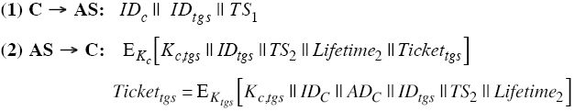
Asking for a ticket(Ticket Granting Ticket) for talking to TGS
Plain text!
Not encrypted
Client
(workstation)
AS
(Authentication Server)
- User name
- TGS name & Request for client authentication
- Current time
AS knows:
All user& service names
All users’ password
Client knows:
user name
user’s password
Ticket Granting Ticket (TGT) :
  user name
  TGS name
  net address
  TGS session key
TGS session key
Encrypted with user’s password
Client decrypts the message using user’s password (key)
the client now has a TGS session key & Ticket (TGT) that can be used to contact the TGS
Client can’t see inside the ticket since the client does not know the TGS key
Encrypted with TGS key
AS finds the keys corresponding to the user name & TGS name
AS creates a ticket which contains :
  User name
  TGS name
  Client network address
  TGS session key
AS seals the ticket with the TGS secret key
TGT = Ticket for TGS
45
Notes:
Stallings Figure 14.1 diagrammatically summarizes the Kerberos v4 authentication dialogue, with 3 pairs of messages, for each phase listed previously.

Slide 46

Obtain service granting ticket from TGS : C→ TGS
Encrypted with TGS key
Server name
Ticket Granting Ticket (TGT) :
  user name
  TGS name
  net address
  TGS session key
TGS
(Ticket Granting Server)
Encrypted with TGS session key
Client
Authenticator
TGS knows:
TGTs granted
TGT expiration times
TG keys
AS keys
Client knows:
user name
user’s password
TGS session key
(3)에서 Client C는 AS에서 받은 Ticket을 그대로 TGS 서버에게 제공하면서 자신이 권한을 가지고 있음을 주장하는 Authenticator도 같이 보낸다.
C가 보낸 Authenticator를 확인해서 C가 정당하다는 것을 TGS는 확인할 수 있어야 하는데, 해당 Authenticator가 Kc,tgs로 암호화되어 있으므로, 이를 복호화 하기만 하면 됨.
이 때 필요한 키 값(Kc,tgs)은 AS에서 만들어 C를 통해 제공한 Ticket 속에 있음. 이를 사용하여, Client C를 인증함.
C를 인증 한 후 TGS는 C에 서비스 티켓을 제공함(4) : 물론 이때도 C와 TGS사이의 비밀키로 암호화해서.
Since the client decrypts the message using the users’ password, the client now has a TGS session key & TGT (Ticket Granting Ticket)
When a client wants to start using a server(service), the client must first obtain a ticket
The client composes a request to send to the TGS
Notes:
Stallings Figure 14.1 diagrammatically summarizes the Kerberos v4 authentication dialogue, with 3 pairs of messages, for each phase listed previously.

Slide 47
Obtain service granting ticket from TGS : TGS → C
TGS
(Ticket Granting Server)
Client
TGS knows:
TGTs granted
TGT expiration times
TG keys
AS keys
Client knows:
user name
user’s password
TGS session key
Session key
- Ticket for requested service
Encrypted with TGS session key
TGS decrypt the TGT using TGS key. TGS can get TGS session key
The TGS decrypts the Authenticator using the TGS session key
TGS check to make sure login names, client addresses & TGS server name are all OK
TGS makes sure the Authenticator is recent
Encrypted with app. server key
The client now decrypts the TGS response using the TGS session key (Kc,tgs)
The client now has a session key (Kc,v)for use with the new server, and a ticket (Ticket_{v})to use with that server
The client can contact the new server using the same format used to access the TGS
Once everything checks out, the TGS …
  builds a ticket for the client & requested server (Ticket_{V})
  The ticket is sealed with the application server key
  creates a session key (K_{C,V})
  seals the entire message with the TGS session key & sends it to the client
47
Notes:
Stallings Figure 14.1 diagrammatically summarizes the Kerberos v4 authentication dialogue, with 3 pairs of messages, for each phase listed previously.

Slide 48


Obtain service
Encrypted with application server key
Client knows:
user name
user’s password
TG key
Session key
Server name
Ticket for requested service
(contains session key)
Encrypted with session key
Authenticator
Application Server
knows:
its own application server key
Client
48
Notes:
Stallings Figure 14.1 diagrammatically summarizes the Kerberos v4 authentication dialogue, with 3 pairs of messages, for each phase listed previously.

Slide 49
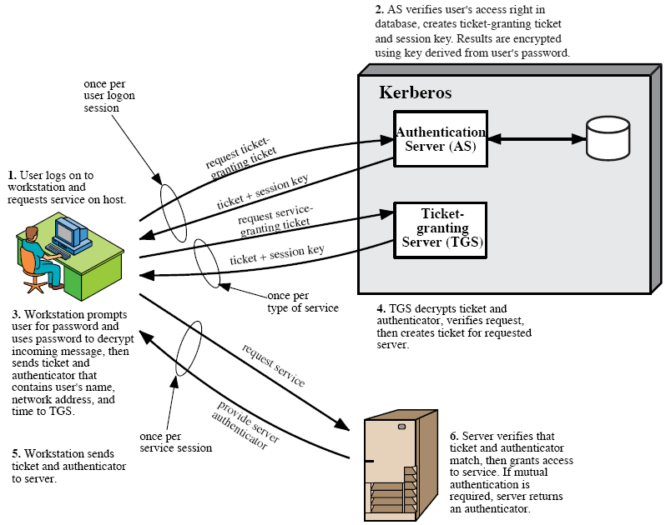
Kerberos 4 Overview
사용자 인증후 ticket 발행
모든 사용자의 해쉬된 패스워드 DB 가짐
Ticket 검사후 서버에 대한 접근 허용 ticket 발행
사용자 암호는 네트웍상으로 전송될 필요 없음
49
Notes:
Stallings Figure 14.1 diagrammatically summarizes the Kerberos v4 authentication dialogue, with 3 pairs of messages, for each phase listed previously.

Slide 50
Tickets in Kerberos v4
50
Each request for a service requires a ticket.
A ticket provides a single client with access to a single server.
Tickets are dispensed by the “Ticket Granting Server” (TGS), which has knowledge of all the encryption keys.
Tickets are meaningless to clients, they simply use them to gain access to servers.
The TGS seals (encrypts) each ticket with the secret encryption key of the server.
Sealed tickets can be sent safely over a network - only the server can make sense out of it.
Each ticket has a limited lifetime (a few hours).
Notes:
The full Kerberos v4 authentication dialogue is shown in Stallings Table 14.1, divided into the 3 phases shown above. The justification for each item in the messages is given in Stallings Table 14.2.

Slide 51
Ticket Contents
51
Session Key for Client/Server
Client name (user login name)
Client Host network address
Server name
Creation timestamp
Ticket lifetime
Notes:
The full Kerberos v4 authentication dialogue is shown in Stallings Table 14.1, divided into the 3 phases shown above. The justification for each item in the messages is given in Stallings Table 14.2.

Slide 52

Session Key
52
Random number that is specific to a session.
Session Key is used to seal client requests to server.
Session Key can be used to seal responses (application specific usage).
Notes:
The full Kerberos v4 authentication dialogue is shown in Stallings Table 14.1, divided into the 3 phases shown above. The justification for each item in the messages is given in Stallings Table 14.2.

Slide 53
Authenticator
53
Authenticators prove a client’s identity.
Includes:
  Client user name.
  Client network address.
  Timestamp.
Authenticators are sealed with a session key.
Notes:
The full Kerberos v4 authentication dialogue is shown in Stallings Table 14.1, divided into the 3 phases shown above. The justification for each item in the messages is given in Stallings Table 14.2.

Slide 54
Kerberos
54
Tickets have a finite lifetime.
Authenticators are only used once (new connection to a server).
Authenticators expire fast !
Server maintains list of authenticators (prevent stolen authenticators).
There is a lot more to Kerberos!!!
Notes:
The full Kerberos v4 authentication dialogue is shown in Stallings Table 14.1, divided into the 3 phases shown above. The justification for each item in the messages is given in Stallings Table 14.2.

Slide 55
Kerberos version 5
55
developed in mid 1990’s
specified as Internet standard RFC 1510
provides improvements over v4
  addresses environmental shortcomings
    encryption alg, network protocol, byte order, ticket lifetime, authentication forwarding, interrealm auth
  and technical deficiencies of Kerberos v.4 as shown below:
    double encryption, non-std mode of use, session keys, password attacks
Notes:
Kerberos Version 5 is specified in RFC 1510 and provides a number of improvements over version 4 in the areas of environmental shortcomings and technical deficiencies, in areas as noted. See Stallings Table 14.3 for details of the Kerberos v5 authentication dialogue.

Slide 56
Weaknesses & Solutions
If TGT stolen, can be used to access network services. | Only a problem until ticket expires in a few hours.
Subject to dictionary attack. | Timestamps require hacker to guess in 5 minutes.
Very bad if Authentication Server compromised. | Physical protection for the server.
56
Notes:
Kerberos Version 5 is specified in RFC 1510 and provides a number of improvements over version 4 in the areas of environmental shortcomings and technical deficiencies, in areas as noted. See Stallings Table 14.3 for details of the Kerberos v5 authentication dialogue.

Slide 57
SSL vs. Kerberos
57
Notes:
Kerberos Version 5 is specified in RFC 1510 and provides a number of improvements over version 4 in the areas of environmental shortcomings and technical deficiencies, in areas as noted. See Stallings Table 14.3 for details of the Kerberos v5 authentication dialogue.

